Slide 1






CAASPP Test Administrator Training Deck
Notes:
Welcome everyone to the training!

Slide 2
How Local Educational Agencies Can Use This Deck
Review the content in the deck.
  Highlighted text on the slide denotes something you may need to change based on your local procedures.
  [Bracketed bold and italic text in speaker notes denotes something you may need to update based on your local procedures.]
Make the deck your own.
  Hide or add any slides, as needed, for your local training.
  You can add district or school logos and change the colors as needed.
  Many slide titles have a (2) after them. Those were needed to post the deck accessibly, but you can remove them for your live presentation if you prefer.
  Insert the break slide (next slide) where needed for your flow.
Please note, following adult learning best practices there are multiple reflection points or activities throughout the training.
  We highly recommend you leave these in. For optimal learning, adult learners need to engage in an activity or reflection for every 12–18 minutes of content.
Please note a couple details about this deck
  It is intended for training test administrators, but there is some information for test examiners which might be useful.
  Some screenshot images are blurred to highlight important areas and for accessibility.
Notes:
On the slides, insert your LEA specific content in the yellow highlighted sections.
In the speaker notes, insert your LEA specific content [where text is in brackets and bold / italic.]

Slide 3

Break Time
Notes:
Insert this slide as needed once you have the flow of your training.

Slide 4
CAASPP Test Administrator Training
Notes:
Welcome everyone to the training!

Slide 5

Agenda
Overview of CAASPP
Test Security
Accessibility Supports and Accommodations
Your Role
Starting a Test Session
Options for Preparing Students
Notes:
Today we will cover
An overview of CAASPP
Test security
Accessibility resources
Your role
Starting a test session
Options for preparing students

Slide 6

CAASPP Overview
California Assessment for Student Performance and Progress (CAASPP) System
Science
California Science Test (CAST)
California Alternate Assessment (CAA)
English Language Arts/Literacy (ELA)
and Mathematics
Smarter Balanced Assessments
CAAs
Spanish Reading/Language Arts
California Spanish Assessment (CSA)
Notes:
Let's start with an overview of the CAASPP system.
As a reminder CAASPP stands for the California Assessment for Student Performance and Progress.
Within the CAASPP system, or under the CAASPP umbrella as we like to say, are the following assessments:
For ELA and math, we have the Smarter Balanced Summative Assessments and the California Alternate Assessments or C-A-As.
For Science we have the CAST, or the California Science Test, and the C-A-A for Science.
And for Spanish Reading / Language Arts we have the CSA, or the California Spanish Assessment.
Let's dig into each one a bit more.

Slide 7
Smarter Balanced Summative Assessments for ELA and Mathematics
Who
Students in grades three through eight and grade eleven
How
Computer Adaptive Test (CAT) and a Performance Task (PT) with a full write
For the CAT, student is scored on number of correct answers and the difficulty of the questions completed
When
[Insert information about your testing windows here.]
Notes:
So, who takes the Smarter Balanced Summative Assessments for ELA and Math.
The answer is all students in grades 3 through 8 and grade 11.
The Smarter Balanced Summative Assessments contain both a Computer Adaptive Test, also called CAT, and a Performance Task, or PT, which contains a full write
For the CAT, the student is not scored only on the number of correct answers.
Instead, the student is scored on the number of correct answers and the difficulty of the questions completed.
That is the adaptive part of the test which feeds the student questions harder or easier depending on how they did on the previous set of questions.
This allows the test to hone in on their exact skill level.
As for the when, our local test windows are [insert here information about local testing schedules]

Slide 8

Optional Exemption
English learner students whose first-time enrollment in a US school was fewer than 12 months ago (cutoff date is after April 15 of previous year) are exempt from the ELA test only. Students must take Mathematics and Science
(if applicable).
Notes:
We do want to note an optional exemption for the Smarter Balanced ELA assessment.
English learners whose first-time enrollment in a U.S. school was fewer than 12 months ago can be exempt from the ELA test only.
The cutoff date is after April 15 of previous year.
Students may take the test if they would like but it will not affect the school’s dashboard results. No action is needed on the part of the LEA. These students are automatically removed from aggregations if they chose not to test.
However, they must take Math and Science (if applicable).

Slide 9
Early Assessment Program (EAP)
Who
Students in grade eleven
How
Students may "opt in" to have their CAASPP scores released to California State University (CSU) system and some California Community Colleges (CCC)
When
One of multiple measures used by CSU and CCC to help determine college readiness and course placement
Notes:
All students participate in the Early Assessment Program, or EAP, by virtue of completing the Smarter Balanced Summative Assessments for English language arts/literacy and mathematics.
Students must authorize the release of their CAASPP (i.e., Smarter Balanced Summative Assessment) results for each assessment to the CSU system.
The release of results for both ELA and math must be completed separately.
At the end of each assessment, students may 'opt in' to have their scores shared with the CSU system by selecting the circle that indicates understanding that CAASPP/EAP results will be shared directly with the CSU.
Students who do not release their results at the end of the assessments may later submit a copy of their score report to the CSU or California Community Colleges (CCC) in which they have enrolled.

Slide 10
CAA for ELA and Mathematics
Who
Students in grades three through eight and grade eleven whose active individualized education program (IEP) dictates an alternate assessment
How
Computer-based test, one-on-one
When
[Insert information about your testing windows here.]
Notes:
Let's move on to the California Alternate Assessments, or C-A-As, for ELA and Math.
These are taken by students in grades 3 through 8 and grade 11, whose active IEP determines the need for an alternate assessment.
The CAAs for ELA and math are computer-based assessments, but not computer adaptive. They are administered 1 on 1.
Only test examiners or TEs who have completed the CAA Moodle trainings for ELA and math are allowed to administer the CAAs for ELA and math.
As for the when our local test windows are [insert here information about local testing schedules]

Slide 11
CAST
Who
Students in grades five, eight, and once in high school (either grade ten, eleven, or twelve)
How
Computer-based test has five segments
When
[Insert information about your testing windows here.]
Notes:
Up next is the California Science Test, or CAST. The CAST is taken by students in grade 5, grade 8, and once in high school, either in grade 10, 11, or 12.
The LEA determines what grade level in high school the CAST will be administered.
12th graders that have not yet taken the CAST will automatically be given assigned the science test.
The CAST is a computer-based assessment that has 5 segments.
Segments 1 and 2 have discreet items – around 12 to 17 per segment.
Segment 3 may be more discreet items or it may be a performance task.
And segments 4 and 5 are performance tasks.
As for the when, our local test windows are [insert here information about local testing schedules]

Slide 12
CAA for
Science
Who
Students in grades five, eight, and once in high school (either grade ten, eleven, or twelve) whose active IEP dictates an alternate assessment
How
Three PTs throughout the year
When:
September through June
Notes:
The CAA for Science.
This assessment is only able to be given by TEs who have gone through the CAA for Science Moodle training.
Like the CAST these are taken by students in grade 5, grade 8, and once in High School (either grade 10, 11, or 12) whose active IEP dictates an alternate assessment.
The CAA for science is a series of three performance tasks administered throughout the year, between September, when the window opens, and the end of the school year.
The goal is to assess each area close to when that instruction was given.
A link to the CAA Science Administration Planning Guides are in the Resource Guide

Slide 13
CSA
Who
Students in grades three through eight, and once in high school
How
Computer-based, nonadaptive, linear assessment
When
Local educational agencies (LEAs) may select their own testing window each year
Notes:
And finally, we have the CSA or California Spanish Assessment.
So who takes the CSA and why?
The CSA is for students in Grades 3–8 and high school.
In high school students can take the CSA once per year in grades 9, 10, 11, and 12.
One of the benefits of this assessment is that LEAs will be able to evaluate the implementation of their Spanish reading/language arts program.
It is important to remember not to compare results with other LEAs in California, as we are finding out that there are many unique programs across LEAs and no two appear to be the same.
If you make comparisons, they shouldn't go beyond your own district.
And it's possible that there are even differences from school to school within the same district.
Basically, you can evaluate your own program in each school or LEA, but you shouldn't compare your results to those of other programs in other LEAs because there is so much variation in programs throughout LEAs in California.
CSA is a computer-based, nonadaptive, linear assessment.
It is also an untimed test, with the estimated testing time of approximately 2.5 to 4.5 hours beginning with the 2024-25 administration, depending on the student’s grade level.
There is a grade level test in each of grades three through eight and one grade band test in high school.
Please note: students in high school can take the CSA once during each of their high school years
The CSA is available as soon as 66% of the instructional year has passed and lasts through the last day of instruction, or the end of June, whichever comes first.
LEAs enter their instructional calendar when setting up windows and can’t start the test before 66% of the instructional year has passed.
LEAs may select their own testing window each year, however, this window is selected by the LEA but is not selected in the Test Operations Management System (TOMS) like other California Assessment of Student Performance and Progress (CAASPP) assessments. This is an important distinction.

Slide 14
Average Testing Times
Content Area | Grade Levels/Spans | CAT | PT | Total
ELA | Three through eight | 45 minutes | 2 hours | 2 hour 45 minutes
ELA | Eleven | 1 hour | 2 hours | 3 hours
Mathematics | Three through five | 45 minutes | 1 hour | 1 hour 45 minutes
Mathematics | Six through eight | 1 hour | 1 hour | 2 hours
Mathematics | Eleven | 1 hour | 1 hour 30 minutes | 2 hours 30 minutes
Notes:
Briefly, let’s talk about the testing times required by each assessment.
[cover the information in the table on the screen]

Slide 15
Average Testing Times (2)
Content Area | Grade Levels/Spans | CAT | PT | Total
CAST | Five, eight, and high school | N/A | N/A | 1 to 2 hours
CAAs for ELA/Mathematics | Three through eight and eleven | N/A | N/A | 1 to 1 hour 40 minutes
CAA for Science | Five, eight, and high school | N/A | 1 hour or less per PT, 3 PTs total | 3 to 5 hours
CSA | Three through five and high school | N/A | N/A | 2 hours 30 minutes to 4 hours 30 minutes
Notes:
[cover the information in the table on the screen]

Slide 16



Pause and Reflect
What sits square?
What is still rolling around?
What are three points to remember?
Notes:
We are now going to pause and reflect.
Take a moment to write down one thing that sits square, one thing that is still rolling around, and three points you want to remember.
[give attendees 3-4 minutes to complete the reflection]
Notes for Facilitators:
This can be done on scratch paper, electronically, or you can print a reflection doc if you choose.

Slide 17

Pause Rules for the
CAASPP System of Assessments
Notes:
Our next section is all about pausing the test, and the rules around the length of the pause.
These rules apply to the Smarter Balanced Summative Assessments for ELA and Math, the CAST and CSA.
The Pause Rules flyer is linked in the resource guide.

Slide 18

Pauses Less Than 20 Minutes
The student
will return to where they left off within a segment and revisit previously answered questions in the current segment; and
will not be able to access previously submitted segments.
Notes:
Let’s start with pauses under 20 minutes.
If the student pauses the test and returns under 20 minutes, then the student will return to where they left off within a segment.
They will be able to revisit previously answered questions within the current segment.
If a TA does not approve a student before the 20 expires, the student will not be able to return to where left off.
However, the student will not be able to access previously submitted segments.
The pause rule does not apply to the following tests: – Smarter Balanced PTs – CAST PT – California Alternate Assessments (CAAs) Note: If a pause in testing is needed while a student is taking a PT, it is recommended that the pause occur between PT segments and not in the middle of a PT

Slide 19
Pause of 20 Minutes or More
The student
returns to the last page containing questions with which the student has not yet interacted with;
cannot return to previously answered segments or questions, even if they are marked for review; and
is paused while working on a constructed response; the partial response will be submitted and unable to be revised.
Notes:
But what about pauses of 20 minutes or more?
For these, the student returns to the last page containing questions with which the student has not yet interacted.
The student cannot return to previously answered segments or questions, even if they are marked for review.
Any highlighted text will not be saved regardless of how long the test is paused.
Notes entered on the digital notepad will be saved.
Global Notes, which are available only for ELA Performance Tasks (PTs), are retained from segment to segment.
If a student is paused while working on a constructed response, the partial response will be submitted and will be unable to be revised.
The pause rule does not apply to the ELA and math performance tasks.

Slide 20

Test Timeout Due to Inactivity
Students are automatically logged out of the test after
30 minutes of inactivity.
  Selecting a menu or an answer is activity.
  Moving the mouse or selecting an empty space on the screen is not considered activity.
Before the system logs out, a warning message will be displayed.
As soon as logout happens, the timer starts for the pause rules.
  The time the student was inactive does not count towards the pause time.
Notes:
And then we have inactivity, which is not initiated by student, but a timeout due to no activity from the student.
As a security measure, students are automatically logged out of the test after 30 minutes of inactivity.
Activity means:
Selecting a menu or an answer.
Using a navigation option in the test (e.g., selecting Next or Back buttons, using the Questions drop-down list).
Please note that moving the mouse or selecting an empty space on the screen is not considered activity.
Before the system logs out, a warning message will be displayed.
Selecting OK in this message will restart the 30-minute inactivity timer.
As soon as the logout happens due to inactivity the pause timer starts.
So, if the student is logged out due to inactivity and logs back in within 20 minutes, they may return to previously answered question.
If the student takes 20 or more minutes to log back in, they will not return to previously answered questions.
The time the student sat idle that caused the logout, is not counted, just the minutes after logout.

Slide 21

Miscellaneous CAASPP Information
Notes:
We have one more topic to cover before we wrap up this section, and that is a collection of miscellaneous background info that we need to know before we jump into our other topics.

Slide 22
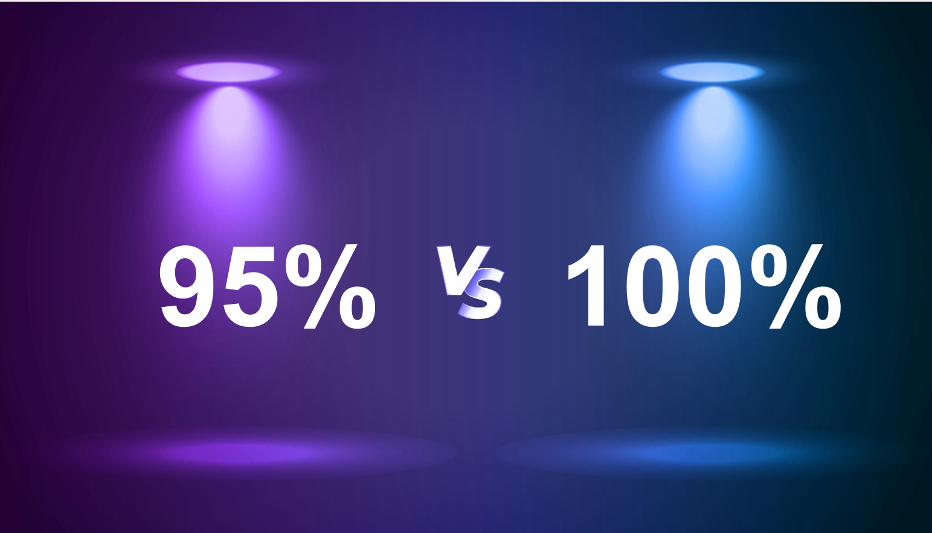
Participation Rate Expectation
Notes:
First up is the participation rate expectation.
We bring this up because there are two different factors here.
As you may know, for the California School Dashboard, there is a penalty for the Academic and Science Indicators if we do not test 95% of our students.
However, the expectation from the state is that we test 100% of our students.
We understand that opt-outs happen, but other than that we want to get as close to the 100% as possible.
The participation rate requirement does not include the optional CSA.

Slide 23
Meeting the 95 Percent Participation Rate
xx percent of schools met the 95 percent participation rate in ELA
xx percent of schools met the 95 percent participation rate in Mathematics
xx percent of schools met the 95 percent participation rate in Science
However
xx percent of high schools met the 95 percent participation rate in ELA
xx percent of high schools met the 95 percent participation rate in Mathematics
xx percent of high schools met the 95 percent participation rate in Science
[Insert local numbers from your Dashboard.]
Notes:
Going back to that California School Dashboard piece, we do want to remind everyone how important it is to make sure that we are meeting that 95% participation rate.
There is a penalty applied to our academic indicators for ELA, Math and Science if we don’t meet the 95%, which affects our overall CA School Dashboard.
We also want to note that the testing done in 2025-26 will affect the 2026 dashboard.
[read the points on the slide, and talk about your participation rate and why it is important]

Slide 24

Test Security
Notes:
Next up, we want to cover test security.

Slide 25

Test Operations Management System (TOMS) Security Affidavits
Notes:
Each year, when you are assigned a role in the Test Operations Management System, or TOMS, you will be required to sign a test security affidavit when you log in to TOMS for the first time.
This is a very important step—one you MUST do before you start testing.
The Test Security Affidavit states that the signer will follow each of the listed items to safeguard the assessments as well as administer them in manners that match the directions for assessments.
So please be sure to read through the form each year.

Slide 26

Non-TOMS Security Affidavits
Notes:
Users who do not require access to TOMS, but have access to secure printed testing materials (including student score reports), must sign the one or both of the following forms:
CAASPP Test Security Affidavit for Non-TOMS Users form.
The link is in your resource guide.
We want you to do a quick reflection on who may need to sign on of these forms.
Think about your classrooms and your school as a whole.
[pause for reflection]
[popcorn around the room to get shared answers]
(Examples: the custodians, teacher’s aides, office staff)

Slide 27

Secure Browser
Notes:
Another security reminder is about the secure browser required for testing.
[insert how your IT department will get the browser on devices, or the date by which this will be done]
Prior to administering the computer-based assessments, please check all devices that will be used and close all applications except those identified as necessary by the school technology coordinator.
After closing these applications, you should open the secure browser on each device.
The secure browser and Student Interface automatically detect certain applications that are prohibited from running on a device while the secure browser is open.
The secure browser will not allow a student to log on if the secure browser detects that a forbidden application is running on the device.
A message will also display that lists the forbidden application(s) that needs to be closed.

Slide 28

Secure
Materials
Notes:
Remember that testing materials are considered secure materials.
This includes the test itself, scratch paper, login cards for students, Directions for Administration or DFAs, etc.
All test materials must remain secure at all times.
Printed materials from the print-on-demand accommodation, CAA DFAs, answer-recording documents, and scratch paper must be kept in a securely locked room or locked cabinet that can be opened only with a key or keycard by staff who are responsible for test administration and have signed a CAASPP Test Security Affidavit.
The only exception to the requirement governing the immediate destruction of printed materials and scratch paper is when students take notes or draft responses to ELA, mathematics, or science PTs and CSA.
To maintain the security of scratch paper, TAs or TEs must direct students to write their names (or some appropriate identifying information) on their scratch paper and then collect and inventory the scratch paper at the end of each test session, as well as upon completion of the test to maintain test security.
The retention of scratch paper (including graph paper) is allowed for the PTs, CAST, CAAs, and CSA.
Do not keep printed test items or passages or scratch paper for future test sessions except as noted for PTs.

Slide 29

Activity: Pop Quiz
Notes:
We are going to play a quiz game to check for understanding.
Please get out a piece of paper and number it one through three or complete this electronically in your resource guide.
Here we go:
Notes for Facilitators:
Ask the question using the question slide.
Ask attendees to jot down their answer
Share the answer with the answer slide
Ask who got it right
Reteach info where needed

Slide 30
Question #1
Question: True or False?
The state expects us to test
95 percent of students on ELA, Mathematics and Science.
Notes:
On to question #1: True or False?
The state expects us to test 95 percent of students on ELA, Math and Science.
[ask attendees to jot down their answers]
[once all attendees have answered on a piece of paper go to next slide]

Slide 31
Answer #1
Question: True or False?
The state expects us to test
95 percent of students on ELA, Mathematics and Science.
Answer: False.
The state expects 100 percent of students to be tested.
Notes:
The answer to this one is false.
The state expects 100% of students to be tested.
We understand that opt-outs happen, but we want to aim for testing all students who are not opted out, not just for hitting the 95%.
[review more if needed]

Slide 32
Question #2
Question: True or False?
Scratch paper can be secured between testing times and returned to the student to use over multiple days.
Notes:
On to question #2: True or False?
Scratch paper can be secured between testing times and returned to the student to use over multiple days.
[ask attendees to jot down their answers]
[once all attendees have answered on a piece of paper go to next slide]

Slide 33
Answer #2
Question: True or False?
Scratch paper can be secured between testing times and returned to the student to use over multiple days.
Answer: Both!
True for PTs, CAAs, and CSA
False for ELA and Mathematics CAT and Science discrete items
Notes:
The answer to this one is Both True and False!
The only exception to the requirement governing the immediate destruction of printed materials and scratch paper is when students take notes or draft responses to ELA, mathematics, CSA or science PTs. So, when students take notes or draft responses to Performance Tasks, they can be saved and then returned to a student to be used over multiple days.
To maintain the security of scratch paper, TAs or TEs must direct students to write their names (or some appropriate identifying information) on their scratch paper and then collect and inventory the scratch paper at the end of each test session, as well as upon completion of the test to maintain test security.
Scratch paper for the ELA, Math, and Science CATs must be destroyed after each testing session and cannot be saved.
[review more if needed]

Slide 34
Question #3
Question: True or False?
A pause of 20 minutes means the student cannot return to previously answered segments or questions, even if they are marked for review.
Notes:
And finally, Question #3: True or False?
A pause of 20 minutes means the student cannot return to previously answered segments or questions, even if they are marked for review.
[ask attendees to jot down their answers]
[once all attendees have answered on a piece of paper go to next slide]

Slide 35
Answer #3
Question: True or False?
A pause of 20 minutes means the student cannot return to previously answered segments or questions, even if they are marked for review.
Answer: True!
A pause of 20 or more means the student cannot return to previously answered segments or questions, even if they are marked for review.
Notes:
This one was a bit tricky, but the answer is true.
A pause of less than 20 minutes qualifies for the lighter pause rules.
20 minutes or more means the student cannot return to previously answered segments or questions, even if they are marked for review.
[review more if needed]

Slide 36

Accessibility Resources Overview
Notes:
Our next section is all about accessibility resources.

Slide 37


Equality Does Not Mean Equity
Notes:
In the past, we often talked about equality in education—providing each student with the same educational opportunities.
Now, we are focused on equitable education—providing each student with the tools and resources they need to be successful in school and to graduate ready for college and career. Those needs can vary greatly by individual student.
Here is another way to think about it.
With equality, we have four bicyclists that all have the same bike.
They have ‘equal’ equipment.
The problem is that one cyclist uses a wheelchair, one is very tall and hunched over on a bike that seems too small, one is using the bike and it looks like a perfect size and one small cyclist is trying to ride a bike that is much too big. ​
So instead, we want equity.
With equity, each cyclist is provided a bike that meets their needs;
the cyclist in a wheelchair is provided a modified bike,
the tall cyclist is now riding a larger bike;
the cyclist who had the bike that was perfectly sized is still riding this bike,
and the small cyclist now has a bike that is appropriately sized.
Equity means that each cyclist has the correct equipment they need to perform successfully.​
Some students need something entirely different to help them achieve their goals.
In this example, when we provide all kids with the exact bike they need, either in size or structure, they are all able to enjoy the full benefits of the activity.

Slide 38

1-2-3-4s of Accessibility—#1
1-2-3-4s of Accessibility: 1
One Purpose:
Access
Notes:
Let’s cover the 1-2-3-4s of accessibility.
The 1 in our 1-2-3-4 is the purpose.
We have one purpose when it comes to accessibility—access.
Students with specific learning needs may require accessibility resources to fully engage and demonstrate mastery of content during instruction and on assessments.
To better serve them, there are a wide range of resources available for CAASPP Summative and Interim Assessments. These resources ensure that the administration of the test meets the needs of all students, including those with disabilities.

Slide 39
1-2-3-4s of Accessibility: 2
One Purpose:
Access
Two Options:
Embedded
Non-Embedded
Notes:
When it comes to the delivery of accessibility resources there are two options:
embedded and
non-embedded.
Embedded resources are digitally delivered as part of the technology platform for the computer-based tests such as text to speech.
Non-embedded resources are provided by the local educational agency, or LEA, outside of the test delivery system such as scratch paper.

Slide 40
1-2-3-4s of Accessibility: 3
One Purpose:
Access
Two Options:
Embedded
Non-Embedded
Three Categories:
Engagement
Presentation
Action and Expression
Notes:
Resources included in the CAASPP tests fall into these 3 basic categories based on the universal design for learning.
There are resources that support students to remain engaged with the assessment:
For example, providing breaks, a separate setting, or even noise buffers.
There are also resources that support students by varying the way the assessment is presented.
For example, all or parts of the assessment might be translated for an English learner, or parts of an assessment might be read aloud to struggling readers through text-to-speech.
And finally, there are resources that support students by allowing them to respond through various actions and expressions:
such as through an adaptive keyboard or by using a scribe.

Slide 41
1-2-3-4s of Accessibility: 4
One Purpose:
Access
Two Options:
Embedded
Non-Embedded
Three Categories:
Engagement
Presentation
Action and Expression
Four Types:
Universal Tools
Designated Supports
Accommodations
Unlisted Resources
Notes:
And the 4 is the four types of resources
Universal Tools are available to all students, based on individual choice and preference.
You do not have to do anything to turn on a Universal Tool, they come built into the test. Examples include zoom, notepad, highlighter, and strikethrough.
There are some non-embedded universal tools that you may have to provide, such as scratch paper.
Next are the Designated Supports.
They are available to any students for whom a need has been identified by an adult who is familiar with the student’s instructional needs.
That’s right, you do not need an individualized education programs (IEP) or Section 504 Plan to get designated supports.
Just an identified need, such as English learner, or struggling reader.
Designated supports include things like translated test directions or text-to-speech.
The next level are Accommodations.
For accommodations, the student does need an active IEP or Section 504 Plan, and the accommodation must be written into the IEP or Section 504 Plan and designated on the Statewide Testing page of the IEP or Section 504 Plan.
Accommodations are things like American Sign Language (ASL), Braille, or word prediction.
I am going to pause here before we move onto the fourth type.
For the three types listed so far—universal tools, designated supports, and accommodations—students who use these during the test will still get a valid test score.
These resources do not change the construct of what is being measured.
The fourth type is Unlisted Resources.
Again, the student needs an active 504 plan or IEP to be able to request these unlisted resources, and there is a process involved in requesting them.
Unlisted resources are resources that are not already identified in the California Assessments Accessibility Resources Matrix, which is the document that lists all the universal tools, designated supports, and accommodations available for CAASPP.
For a student to access an unlisted resource, the test site coordinator may submit a request to the California Department of Education (CDE) through the Test Operations Management System (TOMS) a minimum of ten business days before the student’s first day of testing.
The CDE will review the item and determine if the construct being measured is changed with the use of this resource.
If the construct has not changed, the student will get a valid score.
If the resource will change the construct the student’s score will be removed from aggregations, not be counted as participating for accountability, and be invalidated for CAASPP.
An example of an unlisted resource that would change the construct of the test would be requesting a calculator in grades 3-5 for the math assessment.

Slide 42

California Assessment Accessibility Resources Matrix
Notes:
The California Assessment Accessibility Resources Matrix contains all Universal Tools, Designated Supports, and Accommodations for CAASPP.
The Matrix is your one-stop-shop for information about accessibility resources for these assessments.
The link has been placed in your resource guide.
This document is a great resource, and we recommend that you always keep a copy handy.

Slide 43
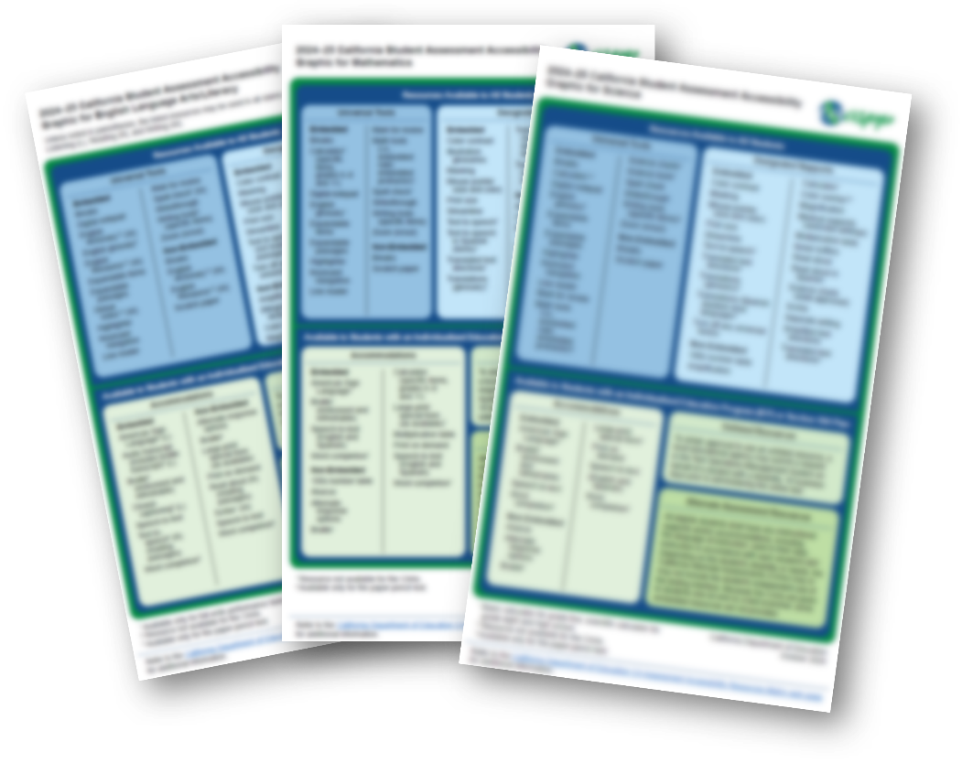
Accessibility Resource Graphics
Notes:
There are also one-page documents that list the available resources for each assessment.
They are called the Accessibility Resource Graphics.
A link to these resources is also included in your resource guide.

Slide 44

Accessibility Resources: Our Local Process
[Insert local process steps for assigning supports here]
[Insert local process steps for assigning supports here]
[Insert local process steps for assigning supports here]
[Insert local process steps for assigning supports here]
Notes:
[Discuss your local process for assigning and uploading accessibility resources.]

Slide 45

Activity: Classification of Resources
Notes:
We are going to do another activity – this time a classification of resources – to practice with accessibility resources.
Notes for Facilitators:
If you are doing this virtually, the links to the graphics are in the resource guide, and the grid will be in the resource guide as well.
If you want to do this on paper, you will need to print the grid from the resource guide and print the Accessibility Resources Graphics for attendees.

Slide 46
Classification of Resources
Test | Engagement | Action/Expression | Presentation
ELA | Insert Here | Insert Here | Color Contrast (DS)
Mathematics | Separate Setting (DS) | Insert Here | Insert Here
CAST | Insert Here | Insert Here | Insert Here
CAA for ELA | Insert Here | Insert Here | Insert Here
CAA for mathematics | Insert Here | Insert Here | Insert Here
CAA for science | Insert Here | Insert Here | Insert Here
Notes:
Together as a table, you will fill out the grid shown on the screen.
This grid is also in your resource guide (or printed if you chose to print it)
Select supports from the Accessibility Resource Graphics and put them in the correct category.
After each resource list if it in a Universal Tool(UT), Designated Support (DS), or Accommodation (A)
[give them five minutes to work on the sheet]
[popcorn around the room to get answers, correct understanding if needed]

Slide 47

Different Roles
Notes:
We want to briefly cover the different roles available for CAASPP before we jump into your responsibilities before, during, and after testing.

Slide 48
Test Administrator
Versus
Test Examiner
Test Administrator (TA)
Administers Summative and Interim Assessments
Confirm test settings
Ensures session security
Access to completion status reports in TOMS
Access to assessment results in CERS (once rostered)
Security affidavit required
Test Examiner (TE)
Credentialed or licensed employee who administers Alternate Assessments
Confirms test settings
Ensures session security
Access to completion status reports in TOMS
Access to assessment results in CERS (once rostered)
Security affidavit required
Notes:
So, Test Administrator, or TA vs Test Examiner, or TE.
What are the main differences?
TAs administer the general Summative and Interim Assessment. TAs do not need to be credentialed or licensed but must be employed by the LEA.
TEs administer the Alternate Assessments 1-1 and they must be a credentialed or licensed employee, who knows the student.
TEs can also administer the general assessments
TAs and TEs both confirm test settings and ensure session security.
They both have access to completion status information and assessment results in CERS, or the California Educator Reporting System.
And for both a security affidavit is required.
So, as demonstrated, the difference is the type of assessment they can deliver for CAASPP.

Slide 49

Let Us Dig Into Your Role
Notes:
Ok, now that we have that background info, let’s dig into your TA role.

Slide 50
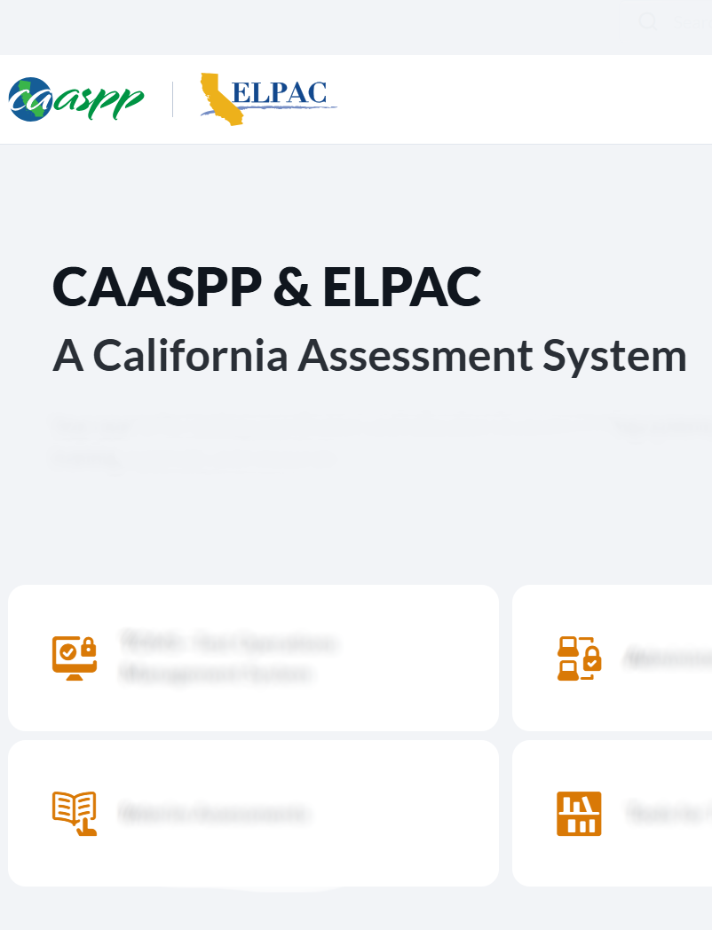
Before Testing
Log on to TOMS to read and sign the CAASPP Security Affidavit:
Navigate to CAASPPP and ELPAC website.
Select the TOMS tile on the home page.
Log on to TOMS.
The first time you log on you will be asked to read and sign the security forms required for your role.
  This must be done before you start testing, otherwise you will not be able to access the test session!
Notes:
We will start with the before testing steps.
The first thing on the list is to log into TOMS and complete the CAASPP security Affidavit.
This MUST be done BEFORE you start a test session.
You will have to verify your account via email and check your junk folders if you do not see the verification code in your inbox.
[review the steps needed, as listed on the screen]

Slide 51

Before Testing (2)
Complete necessary training.
[List local training requirements here.]
TEs have additional required Moodle courses.
TAs have an optional TA Tutorial available.
Notes:
Item number two in the before testing section is to complete necessary training.
[cover what is required for your LEA]

Slide 52

Before Testing (3)
Review the testing schedule.
[Insert info here on where to find local testing schedule.]
[Insert any other info here about the schedule that is important to call out, such as make up days.]
Notes:
Item number three is to review the testing schedule.
[review the test schedule you have inserted into the slide]

Slide 53
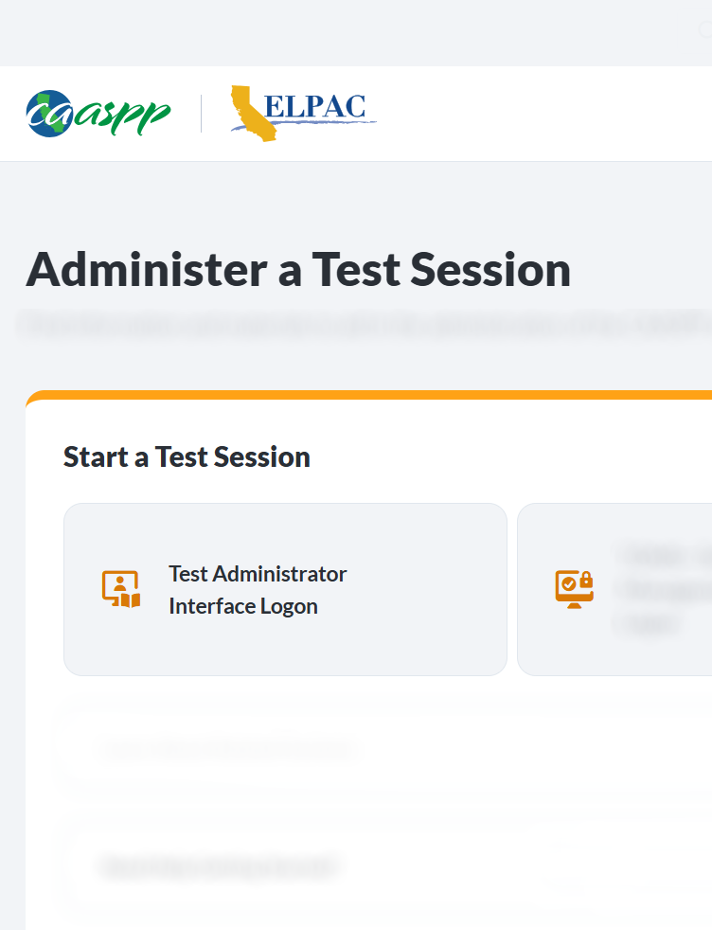
Before Testing (4)
Make sure you can log on to the
TA Interface and access the summative tests:
Navigate to CAASPP and ELPAC website.
Select the Administer a Test Session tile on the home page.
Select the TA Interface button.
Log on to the TA Interface.
Notes:
And item number four in the before testing section, is to make sure that you can log in to the TA interface and can access the summative tests.
[review the steps listed on the slide]

Slide 54
Pause and Reflect (2)
What sits square?
What is still rolling around?
What are three points to remember?
Notes:
We are now going to pause and reflect.
Take a moment to write down one thing that sits square, one thing that is still rolling around, and three points you want to remember.
[give attendees 3-4 minutes to complete the reflection]
Notes for Facilitators:
This can be done on scratch paper, electronically, or you can print a reflection doc if you choose.

Slide 55

Room Prep
Prepare your room:
Cover or take down all displayed instructional materials like vocabulary charts and periodic tables.
Arrange student seats so that students cannot view each other’s answers.
Post “Testing—Do Not Disturb” signs outside of the testing room.
Discuss local protocol for phones during testing.
Notes:
The next section is all about prepping your room for testing.
To do this, you will want to:
Remove instructional charts from the walls.
Arrange students so that they cannot view each other's answers.
Post the “Testing: Do Not Disturb" signs outside your room—the link to these is in your resource guide.
And discuss local protocol for phones during testing.

Slide 56
Room Prep (2)
Set out computers, headphones, and scratch paper
If you need headphones, contact [insert here]
Test | Headphones | Scratch Paper | Graph Paper
ELA | Required | Optional | Not allowed
Mathematics | Required only for Text-to-Speech and Translated Glossaries (Audio) | Optional | Required for grade six and above but can be used in lower grades
CAST | Required only for Text-to-Speech | Optional | Optional
CSA | Required | Optional | Optional
Notes:
Item number two under room prep is to set out computers, headphones, and scratch paper.
On the slide is the list of what is required for each test.
Please note that while scratch paper is optional the LEA is required to have it available for student use
[read through the table]
Note that graph paper for math is only required for grade 6 and up but can be used in lower grades.

Slide 57

Room Prep (3)
Designate a place for backpacks and phones.
Clear the room of any
non-secure people.
Only testing staff and students who are actively testing should be in the testing room.
Any adult in the room must have signed a security agreement (through TOMS or a non-TOMS agreement).
Notes:
Up next for room prep is to designate a place for backpacks and phones.
[talk through any local procedures on this]
And you will need to clear the room of any non-secure people so testing can begin.
What do we mean by non-secure people?
Only testing staff and students who are actively testing should be in the testing room.
Any adult in the room must have signed a security agreement (through TOMS or a non-TOMS agreement)
Unauthorized staff or other adults, including students’ parents/guardians, must not be in the room during testing.

Slide 58

Prepping to Give the Test
Pick up testing materials:
Headphones for the ELA test
Blank scratch paper and graph paper for mathematics in designated grade levels
Student logon information (SSID, name)—remember, this is secure information
Printed items can be picked up from [insert here]
Notes:
Ok, take a deep breath because we are on to the next section – prepping to give the test.
Now that our rooms are ready, we want to gather the supplies needed for testing. This includes:
Headphones for the ELA test
Graph paper if you’re administering the math assessment, and blank scratch paper.
Student log on information (SSID, name) Remember, this is secure information.
When print-on-demand is allowed, students will print to a secured printer and then given to the student. It does not pre-print the test.
Also, if you have any printed materials or forms, you will want to pick those up from [insert local procedure for this]

Slide 59

Prepping to Give the Test (2)
Make sure you have Preparing for Administration (PFA) or Scripts as needed.
Scripts for Smarter Balanced and CAST can be found in the CAASPP Test Administration Manual and are not secure.
PFAs are secure and can be found in TOMS.
To ensure that all students are tested under the same conditions, the TA should adhere strictly to the administration script for a particular assessment unless a student is assigned the non-embedded designated support for simplified test directions.
Notes:
Make sure you have the Preparing for Administration (PFA) or Scripts before testing begins.
PFAs and Scripts for Smarter Balanced and CAST can be found in the CAASPP Test Administration Manual and are not secure.
Teachers can use the electronic scripts or print them for use during test administration.
These can be found on caaspp-elpac.org
As a reminder, to ensure that all students are tested under the same conditions, the TA should adhere strictly to the administration script for a particular assessment unless a student is assigned the non-embedded designated support for simplified test directions.

Slide 60

Prepping to Give the Test (3)
Review student information in TOMS to verify test settings and identify students with Accessibility Resources.
Changes should be directed to
[insert directions here for your LEA].
List steps for what to do if the information is wrong for a student.
Notes:
The next step in prepping to give the test is to review student information in TOMS to verify test settings and identify students with Accessibility Resources
Changes should be directed to [insert directions here for your LEA]
List steps for what to do if the info is wrong for a student
If a student is assigned "separate setting" for testing, work with [insert name here] to arrange testing for this student.

Slide 61

Prepping to Give the Test (4)
Talk to grade eleven students about EAP.
[Insert any local procedures or lists you use for them to check this information]
Notes:
One more test prep item, and that is an EAP.
EAP stands for the Early Assessment Program.
All grade eleven students participate in EAP by virtue of completing the Smarter Balanced Summative Assessments for ELA and math.
Students must authorize the release of their Smarter Balanced results for each assessment to the CSU system.
The release of results for both ELA and mathematics must be completed separately.
Students who do not release their results at the end of the assessments may later submit a copy of their score report to the CSU or California Community Colleges (CCC) in which they have enrolled.
The release of the CAASPP results will not affect a student’s application for admission.
Results are only used to determine a student’s placement after he or she has been admitted to the CSU. Some, but not all, CCC accept EAP scores.
Students may submit a copy of their score report to a CCC if requested.
Once a student releases their score, if they change their mind, they must reach out to the college. The CDE cannot reverse this decision.
[insert here local procedure for talking to grade 11 students about EAP]

Slide 62

Activity: Thumbs Up, Thumbs Down
Notes:
Ok that was another big chunk of information, so we want to give you some processing time.
This time we are going to play Thumbs Up, Thumbs Down.
I am going to offer out a statement. If you agree with it, give me a thumbs up, if you disagree, give me a thumbs down.
Notes for Facilitators:
You will say the statement on the slide.
If attendees agree they will give a thumbs up, if they disagree, a thumbs down.
Reteach as needed based on attendee responses.

Slide 63
Statement #1
Thumbs Up? or Thumbs Down?
You need to log on to TOMS before you can start a test session.
Notes:
Ok statement number 1:
You need to log into TOMS before you can start a test session.
[wait to see how attendees respond]
This was a thumbs up.
You need to log into TOMS before testing to sign the security affidavit.
If you do not do this, you will not be able to start a summative test session.
This is not something you want to run into while you have a classroom full of students waiting for you to start the test session.
So please be sure to get this completed before you get near testing time.

Slide 64
Statement #2
Thumbs Up? or Thumbs Down?
You can leave instructional materials on your walls uncovered during testing.
Notes:
Ok statement number 2:
You can leave instructional materials on your walls uncovered during testing.
[wait to see how attendees respond]
This is a thumbs down.
You need to remove or cover all instructional materials during testing.

Slide 65
Statement #3
Thumbs Up? or
Thumbs Down?
You need to read the testing scripts verbatim to all students.
Notes:
Let’s do one more.
Statement number 3.
You need to read the testing scripts verbatim to all students.
[wait to see how attendees respond]
This is a thumbs up.
To ensure that all students are tested under the same conditions, you should adhere strictly to the administration script unless a student is assigned the non-embedded designated support for simplified test directions.
Scripts for Smarter Balanced and CAST can be found in the CAASPP Test Administration Manual and are not secure.
You can use the electronic scripts or print them for use during test administration.

Slide 66

Classroom Logistics for Starting a Test Session

Slide 67

Starting a Test Session (1)
Start a testing session and write the Session ID on the board.
Provide a quiet environment void of talking or other distractions that might interfere with a student’s ability to concentrate or might compromise the testing situation or environment.
Notes:
Ok, this next section is all about starting a test session.
Before we jump in, I want to let you know that we will cover, in detail, later in this training the steps you will follow to start a test session.
For this section, we are going to cover your role while starting a test session.
So, hold on to any questions you have about the “how” and I promise we will cover them.
First up, for your role is to start a testing session and write the Session ID on the board.
Students will need this ID to log into the test.
You will also want to ensure you provide a quiet environment void of talking or other distractions that might interfere with a student’s ability to concentrate or might compromise the testing situation or environment.

Slide 68

Starting a Test Session (2)
Review student information in the TA Interface to verify test settings as you let students into the Test Session.
List steps for what to do if the info is wrong for a student.
Read directions verbatim.
Notes:
As you begin testing:
Review student information in the TA interface to verify test settings.
Note: If the information is incorrect, [list what your local process is for incorrect information].
Next, I know we have covered this in detail, but one more time for good measure, you will need to read the directions/script verbatim to maintain accuracy and consistency across the district.

Slide 69

Starting a Test Session (3)
Ensure that students do not have access to digital, electronic, or manual devices (cell phones, smart watches) during testing unless it is an approved medical support.
Double check for phones and Bluetooth earbuds.
Hang “Unauthorized electronic devices may not be used at any time during the testing session” signs where clearly visible to students in the testing environment as a test security reminder.
Staff should actively monitor the test session.
Notes:
Also when starting a test session, you will want to ensure that students do not have access to digital, electronic or manual devices.
This includes cell phones, smart watches, etc., unless it is for an approved medical support.
Check for phones and Bluetooth earbuds.
[Insert local protocol for storage of devices during testing]
Ensure signs regarding "unauthorized electronic device use is prohibited" are clearly visible to students as a test security reminder.
What should you be doing during this time? Great question, lets cover that on the next slide.
Facilitator note: these are on the resource guide.
https://ca-toms-help.ets.org/s/pdf/CAST-Administer-an-Online-Test-Session.pdf
https://www.caaspp-elpac.org/s/docs/CAASPP.test-administrator-checklist.2024-25.docx

Slide 70

During Testing
Be up, walking around the room so that students are actively supervised. Actively monitor to make sure the student has a clear desk free of nonsecure items like notes, or notebooks.
Students are prohibited from
viewing other students’ answers;
distracting or interrupting other students; and
accessing or using unauthorized electronic devices that allow access to outside information, communication, or the ability to photograph or copy test content.
  This includes, but is not limited to, cell phones, smart watches, tablets, cameras, and electronic translation devices.
[Insert your local practice or contact here.]
Notes:
During testing you want to be up, walking around the room so that students are actively supervised by a trained TA or TE. Actively monitor to make sure the student has a clear desk free of nonsecure items like notes, or notebooks.
Remember that students are prohibited from:
viewing other students’ answers
distracting or interrupting other students
accessing or using unauthorized electronic devices that allow access to outside information, communication among students or with other individuals outside the testing environment, or the ability to photograph or copy test content
This includes, but is not limited to, cell phones, smart watches, tablets, cameras, and electronic translation devices
You should be keeping an eye out for these things while you are walking around the room.
If a student runs into a test delivery issue (i.e test skipping questions, unable to click on items)... ... pause the test immediately and let their site coordinator know
Facilitator note: This might be a good point to stop and discuss possible issues that might be common for your site.

Slide 71

During Testing (2)
Reminder, no one other than the student themself is permitted to review a student’s responses to the Smarter Balanced Assessments, CAST, or CSA in the testing interface or students’ notes on scratch paper.
Notes:
We also want to throw in a reminder here that, TAs and TEs are not permitted to review student responses to the Smarter Balanced assessments, CAST, or CSA in the testing interface or students’ notes on scratch paper.
So, do your best not to look at student responses or test questions while you are walking around, as it is prohibited.

Slide 72

During Testing (3)
If a student asks for assistance manipulating a test item or answering a test question, the TA cannot help them.
The TA can encourage them to reread the directions, and say, “I can not help you with the test. Try to do the best you can.”
Notes:
The next one can be a bit tricky, but if a student asks for assistance manipulating a test item or answering a test question, you cannot help them.
Instead, you can encourage them to reread the directions, and say, “I can’t help you with the test. Try to do the best you can.”
This includes help navigating the testing platform.

Slide 73

During Testing (4)
Collect the login cards once everyone is logged on.
All students’ ID information must be collected at the end of each test session, stored securely, and then destroyed securely.
The loss of logon information is considered a security incident at the local level and does not need to be reported in Security Test and Incident Reporting System (STAIRS).
If students will be logging on to multiple tests in one day, collect the login cards after the last logon of the day has been completed.
Notes:
As testing is wrapping up for the day, collect all login cards and store them securely. Reminder to collect all scratch paper. Only scratch paper for the PTs, CSA, and CAST can be securely stored. All scratch paper for the Smarter Balanced ELA/Math assessments must be securely destroyed.
That’s right, all student ID information must be collected at the end of each test session, stored securely, and then destroyed securely.
The loss of logon information is considered a security incident at the local level.
This does not need to be reported in STAIRS (Security Test and Incident Reporting System) however it is not something we want happening.
If students will be logging in to multiple tests in one day, collect the login cards after the last login of the day has been completed.

Slide 74

Student Breaks During Testing
If a student needs a break, pause the test. Student options include
restroom;
water; and
wiggle.
Students cannot access technology during breaks.
Notes:
Earlier in this presentation we covered the pause rules in terms of what students can and can’t do when they return to the test.
For this section, lets cover what a student break actually looks like.
If a student needs a break, pause the test.
The student can then:
[update these options as needed for local procedures]
Go to the restroom
Get a drink of water
Go outside to get the wiggles out
Students CANNOT access technology during breaks.
Also, remind students to keep the break under 20 minutes.

Slide 75

Student Breaks More Than 20 Minutes During Testing
If a student needs a break of more than 20 minutes, or will not finish by the end of the testing session, the student should
review all questions started; and
complete all questions marked for review (they cannot access these later—remember the pause rules).
In the event of a fire alarm, internet outage or health concern that lasts more than 20 minutes the TA should alert the Site Coordinator so they can appropriately address the issue.
Notes:
But what happens if a student needs a break of more than 20 minutes or needs a break and you know you will wrap up testing for the day before they return.
If a student needs a break of more than 20 minutes, or will not finish by the end of the testing session, students should:
review all questions they have started; and
complete all questions marked for review.
they cannot access these later—remember the pause rules.
in the event of a fire alarm, internet outage or health concern that lasts more than 20 minutes the TA should alert the Site Coordinator so they can appropriately address the issue

Slide 76

Student Breaks More Than 20 Minutes During Testing (2)
Collect all materials, write student names on scratch paper, and collect login cards.
These cannot remain on student desks.
Printed materials, scratch paper, the Directions for Administrations (DFAs) and documents with student information must be securely stored in a locked location that can be opened only with a key or keycard by staff responsible for test administration.
Notes:
The second part of breaks longer than 20 minutes is to collect all materials, write the student's name on scratch paper, and collect login card.
Remember these cannot remain on student desks.
Printed materials, scratch paper, the DFA(s), and documents with student information must be securely stored in a locked location that can be opened only with a key or keycard by staff responsible for test administration.

Slide 77

Student Breaks More Than 20 Minutes During Testing (3)
If the student will not complete testing the same day, [insert your local procedure here].
Notes:
And if the student won’t complete testing the same day, mark the student as incomplete on your roster [insert other local process if different from what is listed on the slide].

Slide 78

When Students Finish Testing Each Day and Other Students Are Still Testing
Students need to do an independent activity and should not be disturbing or assisting other students.
No discussion of test materials.
[Insert your local procedures here.]
Notes:
Now, if the student finishes testing and other students are still testing, they can hang out and read, draw, etc.
Just remember, they shouldn’t be disturbing or helping other students who are still testing, and no discussion of test materials may occur.
This includes a debrief of the questions they saw on the test.

Slide 79

When Students Finish Testing Each Day
Collect secure materials:
All student ID information must be collected at the end of each test session, stored securely, and then destroyed securely.
Scratch paper can be retained for the PT by the TA in a secure location and returned to student in a subsequent session; shredded after last session.
Do not place in the recycle bin when destroying secure documents!
Notes:
When its time to wrap up testing for the day, make sure you collect secure materials:
All student ID information must be collected at the end of each testing session, stored securely, and then destroyed securely.
Scratch paper can be retained for the Performance Task by the TA in a secure location and returned to student in a subsequent session; shredded after last session. Scratch paper used on the CAT must be destroyed after each testing session and may not be retained.
Do not place secure materials in the recycle bin when destroying secure documents!
[talk about your local process for materials when two test sessions will happen in one day]

Slide 80

As Testing Wraps Up
Monitor completion status of your students [insert local procedures for this].
Notes:
As testing wraps up altogether, be sure to monitor the completion status of each of your students.
Did you have a student who didn’t finish one of the days when all the other students did?
[insert local procedures for this]

Slide 81

As Testing Wraps Up (2)
Do not retain materials:
No copies of the test items, stimuli, reading passages, PT materials, or writing prompts may be made or otherwise retained.
No device may be used to record or retain test items, reading passages, or writing prompts.
These materials must not be discussed with or released to anyone.
Test items, stimuli, reading passages, or writing prompts must not be used for instruction.
Do not review PTs to have a discussion later, this is a violation and is reported as a security breach.
Notes:
Here is what the CAASPP Testing Manual says about not retaining secure materials:
Do Not Retain Materials.
No copies of the test items, stimuli, reading passages, PT materials, or writing prompts may be made or otherwise retained.
No digital, electronic, or manual device may be used to record or retain test items, reading passages, or writing prompts.
These materials must not be discussed with or released to anyone via any media, including fax, email, text message, social media websites, etc.
Test items, stimuli, reading passages, or writing prompts must not be used for instruction.
Do not review PTs to have a discussion later, this is a violation and is reported as a security breach.

Slide 82

As Testing Wraps Up (3)
Secure paper items must be collected and inventoried and then immediately shredded upon a student’s completion of the test.
Double delete secure materials from your computer or devices.
  Delete and then empty recycle bin.
Do not record test items, talk about test items, teach to test items.
Notes:
Testing wrap up means the secure paper items must be collected and inventoried. Then you immediately shredded these materials upon a student’s completion of the test.
Secure papers includes:
Printed test items or passages;
scratch paper;
notecards or paper that include student logon information; and
printed DFA(s) for the CAAs.
[insert local process for completing this]
Be sure to double delete electronic secure materials from your computer or devices.
That means delete them and then empty recycle bin.
Do no record test items, talk about test items, teach to test items, share test items with the media, etc.
Its common sense, but we have to say it.

Slide 83

As Testing Wraps Up (4)
Do not review student answers.
LEA CAASPP coordinators, CAASPP test site coordinators, and TAs are not permitted to review student responses to the Smarter Balanced Assessments, CAST, or CSA in the testing interface or students’ notes on scratch paper.
Staff are not permitted to review student responses to the Smarter Balanced Assessments, CAST, or CSA in the testing interface or students’ notes on scratch paper.
Notes:
And I know we have said this before, but one last reminder—do not review student answers.
Staff are not permitted to review student responses to the Smarter Balanced assessments, CAST, or CSA in the testing interface or students’ notes on scratch paper.

Slide 84

Technology: Administering a Test
Notes:
Earlier we covered your role in starting a test session and promised more details on the “how to”.
Well, now is that time.
Let’s cover how to start a test session.

Slide 85
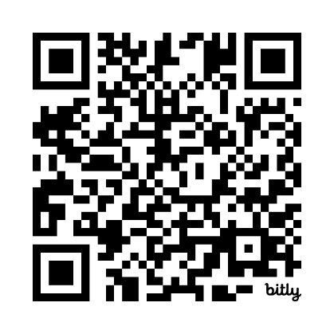
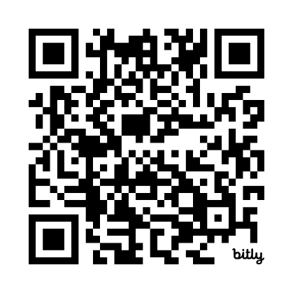
How To Start a Test Session Resources
How To Video
How To QRG
CAASPP and ELPAC
Quick Reference Guide:
How to Access a Practice or Training Test Through the Student Interface
CAASPP and ELPAC Starting and Stopping a Test Session Video (YouTube)
Notes:
In your resource guide are links to both a video and a quick reference guide that will repeat the steps we are covering here.
The QR codes are also on the slide.
Let’s walk through it.

Slide 86
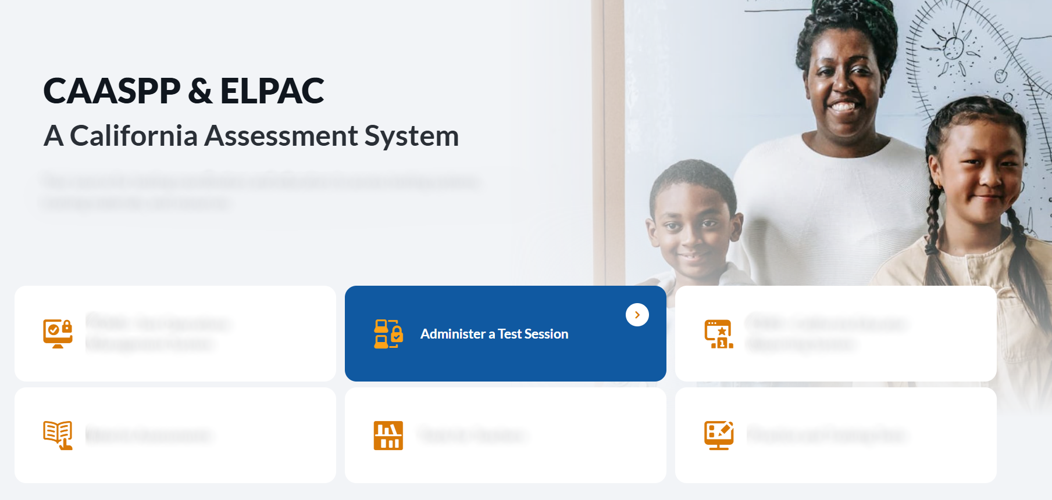
Access the Administer a Test Session Tile on the CAASPP & ELPAC Website
Notes:
The first step is to navigate to the CAASPP & ELPAC Website.
On the homepage you will select the Administer a Test Session tile.

Slide 87
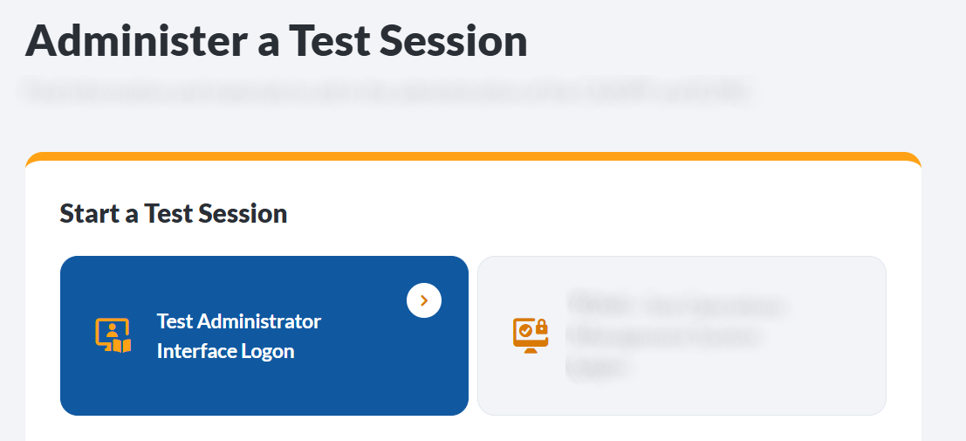
Select the Test Administrator Interface Button
Notes:
This will take you to the Administer a Test Session web page.
From here you will select the Test Administrator Interface button.

Slide 88
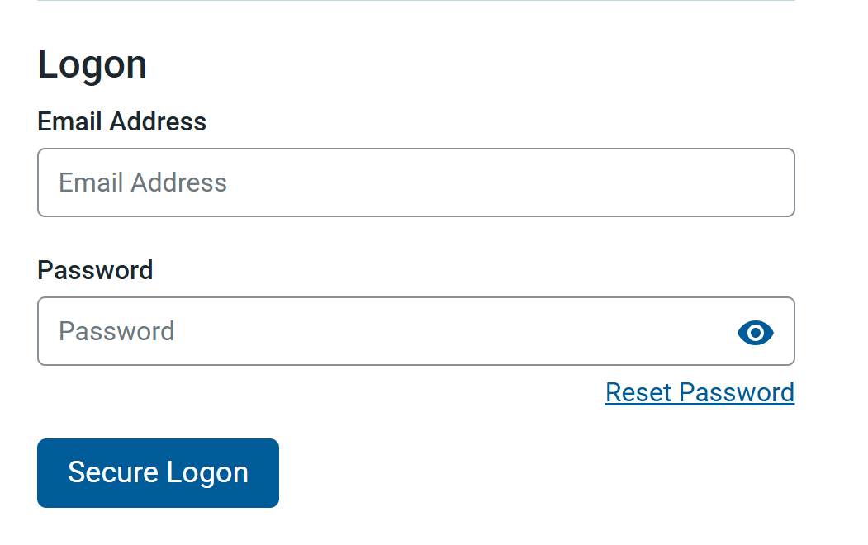
Log On to the System
Notes:
Next you will log on to the system using your TOMS credentials.

Slide 89
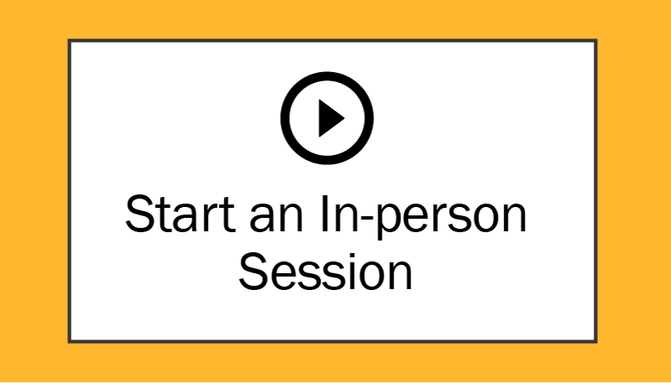
Start an In-Person Test Session
Notes:
Select the Start an In-person Session button.

Slide 90
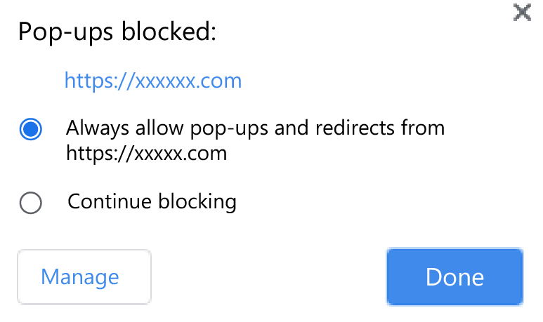
Allow Pop-Ups
Notes:
A pop-up blocker may show up.
If it does, make sure you allow for popups.

Slide 91
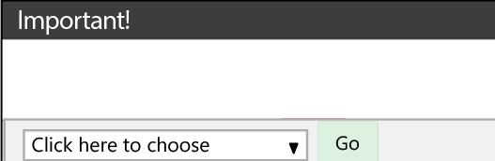
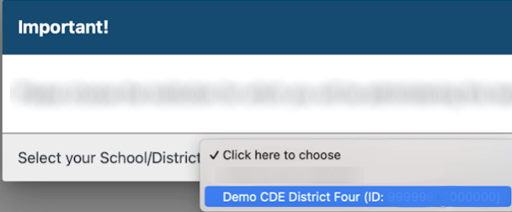
Select a Role or School If Needed
If you have more than one role, you will receive a message and will need to select the appropriate role.
If you have more than one school, you will select the school you are administering for.
Notes:
If you have more than one role, you will receive a message and will need to select the appropriate role.
If it is not already populated, the test administrator must select the appropriate institution from the drop-down list.
Select the Go button after making your selection.

Slide 92
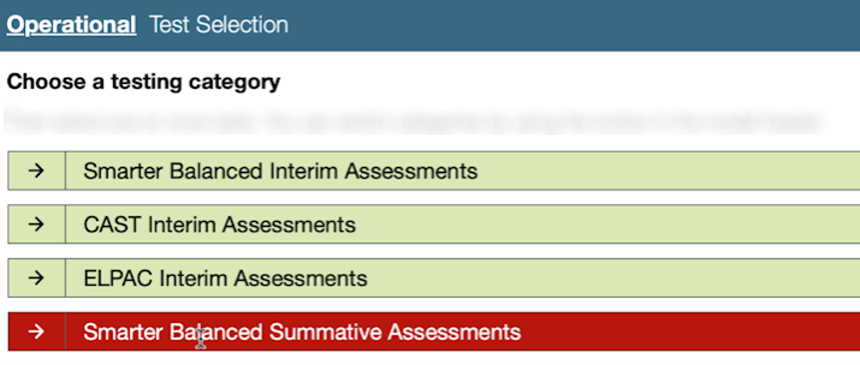
Select the Test(s) You Will Administer
Notes:
You will see the full list of tests available.
Depending on the time of year and the user’s role, all tests may not be available in the Test Administrator Interface.
So, users won’t always find all these options available for test selection.

Slide 93
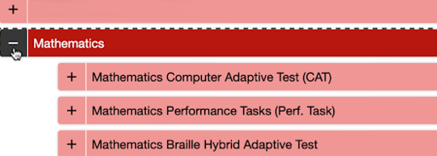
Select the Test(s) You Will Administer (2)
Smarter Balanced Summative Assessments section
Notes:
To expand a collapsed test group, select the Plus plus-sign icon.
To collapse a test group, select the Minus minus-sign icon.
To expand the list of all tests, select the Expand All outward arrows icon.
To select individual tests, mark the checkbox for each test to be included.
Remember you can drill down to start just a CAT or a PT for ELA and Math.

Slide 94
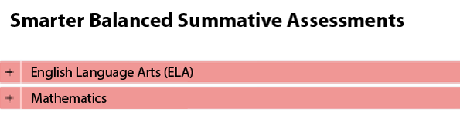
Start Operational Session
Notes:
Once the Start Operational Session button is selected, a visual warning will let the test administrator know that a summative assessment is about to be administered.
Select OK.

Slide 95
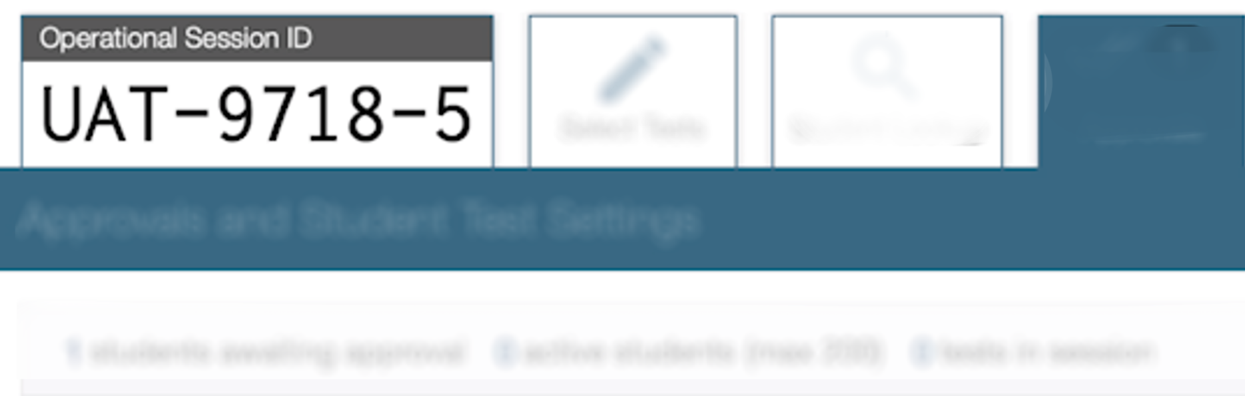
Show the Session ID
Notes:
Write the Session ID on the board for students.
Keep the Session ID for your records in case a Security Test Incident needs to be filed.

Slide 96

Read the Script Verbatim
Notes:
Read the first part of the administration script that explains the test rules about answering questions, pausing the test, the structure of the test, what happens when answers have been submitted, and all other test rules.
Remember to read it verbatim.
I want to pause and note here that we will be mentioning this script throughout this section.
You will read parts of the script at certain points during login.
The point is to have all TAs across the state say the same thing in the same way.
The script is a helpful tool for you during testing.

Slide 97
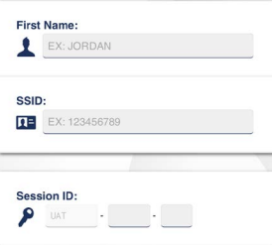
Hand Out Student Credentials
(Remember, These Are Secure)
First Name:
Student’s first name in CALPADS
SSID:
Student’s Statewide Student Identifier (SSID)
Session ID:
Generated by the test administrator (case-sensitive)
Notes:
Write the Session ID on the board for students.
Keep the Session ID for your records in case a Security Test Incident, needs to be filed.

Slide 98

Read More of the Script
Notes:
Read the administration script that explains how to sign in, what to do if the information on their card is incorrect, that you will be walking around to help, and how to select the correct test.
Again, read it verbatim.

Slide 99
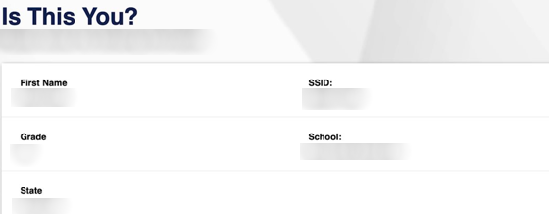
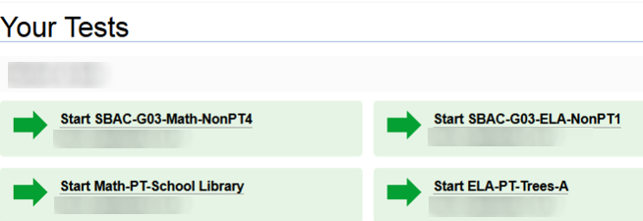
Verification and Test Selection
Student will verify their identity.
Student selects their test.
Only the tests that the TA selected for the test session and those that have not been completed are selectable to students.
Notes:
Student will verify their identity and select their test.
Please note that only the tests that the TA selected for the test session and those that have not been completed are selectable to students.
Ensure that all students have successfully started the correct test and are now waiting for the test administrator’s approval.
If the student information is incorrect, DO NOT test the student.

Slide 100
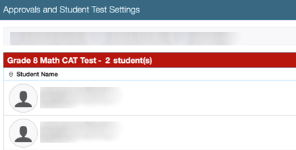
Make Sure Students Are Taking the
Correct Test
Notes:
In the Test Administrator Interface, you will see which students have selected which test(s).
If the student selected an incorrect test, DO NOT test the student. DO NOT approve the test.

Slide 101
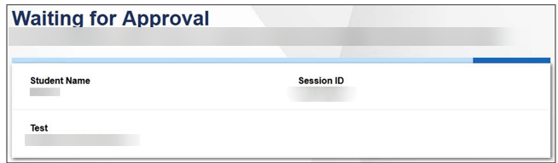
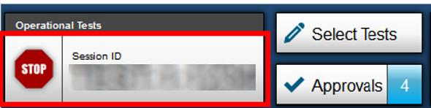
Students Then Wait to Be Let In
Student Screen
TA Screen
Notes:
The Test Administrator will be notified once students log in.
Students will be in a 'waiting room" until the TA 'approves' the student to begin testing.

Slide 102
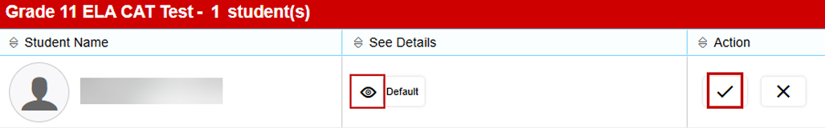
Check Accessibility Resources for Students
Notes:
It is extremely important to check the test settings for students prior to approval to verify that the student is assigned the appropriate supports.
Select the See Details eye icon to view the student’s settings for the current test.
For example, if the student had been assigned the designated support to turn off any universal tool(s), the test administrator can toggle the individual universal tools on and off.
“Custom” in the See Details column indicates the student has been assigned test settings.
Approve students to test by selecting the Approve check mark icon in the Actions column for individual students or the Approve All Students button for each group of tests.
It is important that test administrators get an up-to-date test settings report for their students from site coordinators to verify test settings displayed in the Test Administrator Interface.
If you know a student’s test settings are incorrect, deny the student by selecting Deny “X” icon.
[insert local process to correct the test settings in TOMS and test the student on another day.]

Slide 103
Read More of the Script (2)
Notes:
Read the administration script verbatim that explains how to check the sound and video and what students should do if they cannot hear the sound or see the video.

Slide 104
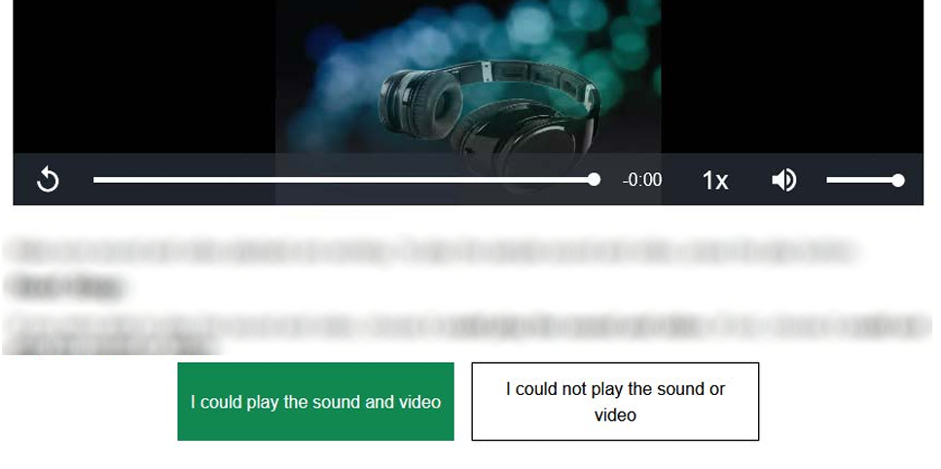
Students Complete Sound and Video Check
Common Problems with Sound:
Verify the headphone is plugged into the correct jack.
Check the volume control on the headphone.
Check the volume/audio on the Chromebook.
Audio/Video Checks page
Sound and Video Playback Check section
Notes:
Be sure to have the students complete the sound check prior to beginning the test.
Some common problems with sound include:
The headphone is not plugged into the correct jack.
The volume control on the headphone is low or off.
The volume/audio on the Chromebook is low or off.

Slide 105
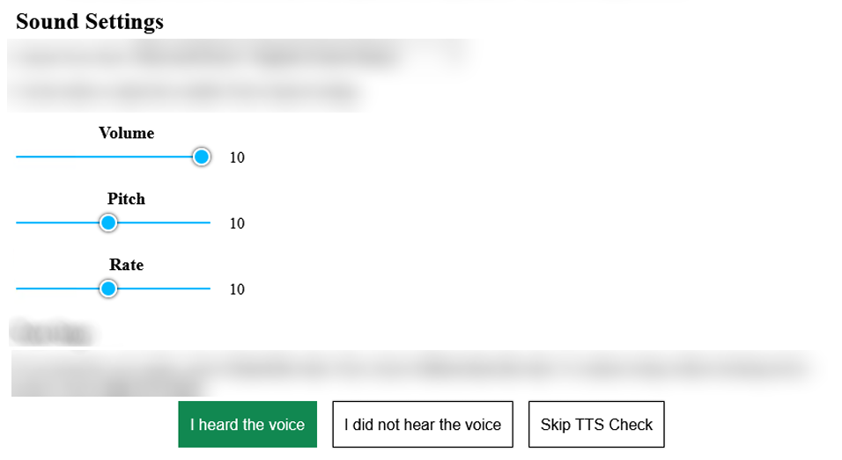
If A Student Has Text-to-Speech, They Will Have A Sound Check
Text-to-Speech Sound Check page
Notes:
The text to speech is slightly different than the general sound check.
If you have students with this resource, read the administration script explaining how to set up and test the text-to-speech or speech-to-text resource to the individual students who have this accommodation.

Slide 106
Read More of the Script (3)
Notes:
Read the administration script that explains what is available on the tutorial page including help with test settings and the Help Guide, and the portion that tells students to select Begin Test Now when they are ready to begin the test.

Slide 107
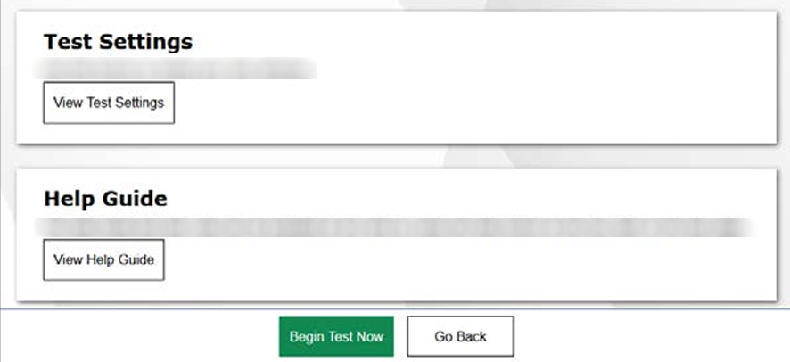
Students Will Select Begin Test Now Button to Begin Testing
Instructions and Help page
Notes:
Students will select the Begin Test now button to begin testing.

Slide 108
Monitor Student Status As Needed
Test Administrator Interface page shows the percentage of items that have been delivered to the student.
Notes:
In addition to circling the room, the test administrator monitors the test each student is taking by referring to the Tests table in the Test Administrator Interface.
By default, students are listed in alphabetical order.
To pin a student’s information to the top of the list, select the "Pin" push-pin icon in the Actions column.
This feature can be used to make it easier to view the test status of select students who may need closer monitoring during their test session.
While the Test Administrator Interface is designed to refresh automatically every minute, the test administrator can refresh it manually at any time by selecting the Refresh Page button.

Slide 109
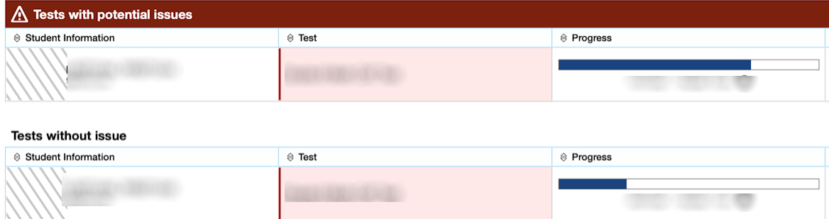
Test With Potential Issues
If students’ tests might have some issues, the Test Administrator Interface will automatically separate those tests into a “Tests with potential issues” section.
Notes:
If students’ tests have been idle, are unexpectedly disconnected from a session, or have pending requests for print-on-demand, the Test Administrator Interface will automatically separate those tests into a “Tests with potential issues” section.
If a student’s test is flagged as a test with potential issues, that student’s information will appear with a red bar over it, and it will be placed before the information for students whose tests were previously pinned.

Slide 110
If a Student Has a Question—Read More of the Script
Notes:
If the student asks a question about an item, read the script in your test administration script.
But what if you notice a student is having trouble focusing?
Well, there is a script for that as well!
If the test administrator notices that a student is having difficulty maintaining focus and is not progressing through the test, the test administrator may use the statement in the administration script provided for helping to keep a student focused.

Slide 111
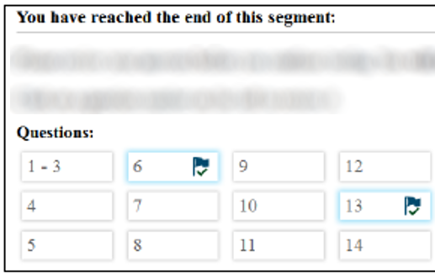
As Students Finish Testing
At the end of each segment, students are presented with a screen prompting them to review answers (marked or unmarked) for all items available to the student.
Reminder: a student may not return to a segment once it has been completed.
Notes:
If students’ tests have been idle, are unexpectedly disconnected from a session, or have pending requests for print-on-demand, the Test Administrator Interface will automatically separate those tests into a “Tests with potential issues” section.
If a student’s test is flagged as a test with potential issues, that student’s information will appear with a red bar over it, and it will be placed before the information for students whose tests were previously pinned.

Slide 112
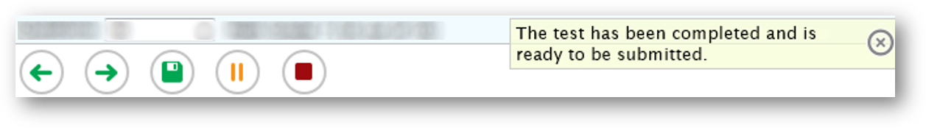
Reaching the End of a Test—End Test Button
After students answer the last item on the test, the End Test button will appear in the upper-left corner of the screen.
Notes:
After students answer the last item on the test, the End Test button will appear in the upper-left corner of the screen.

Slide 113
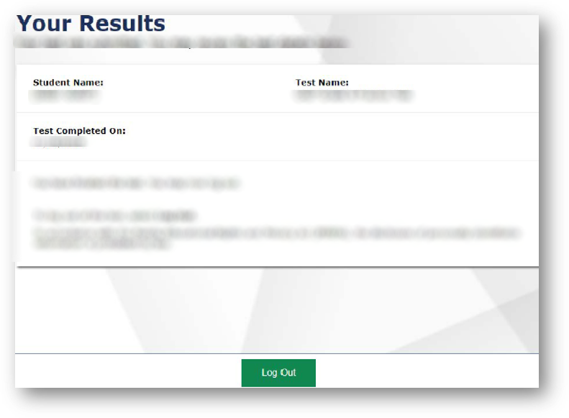
Reaching the End of a Test—Confirmation Screen
When a student has submitted the test, they will receive a confirmation screen.
Reminder: students may not return to a test once it has been submitted.
Notes:
When a student has submitted the test, he or she will receive a confirmation screen.
Reminder: students may not return to a test once it has been submitted.

Slide 114
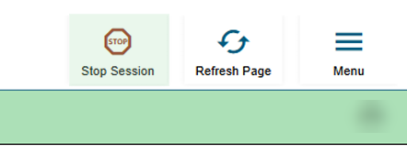
If You Need to Stop a Test Session
Read the script and give warning 10 minutes prior
Select the Stop icon on the session ID bar to stop the test
An “Important!” box will appear, requesting verification to end the session and log students out
Select OK to continue or Cancel to keep the test session open
Notes:
When there are 10 minutes left remaining in an open test session, that is the time to begin reminding students to review their questions.
One very important step in this process is to remind all students to finish all questions that may be in a set.
A set is a page that contains more than one question.
You will then Select the Stop icon on the session ID bar to stop the test.
An “Important!” box will appear, requesting verification to end the session and log students out.
Select OK to continue or Cancel to keep the test session open.

Slide 115
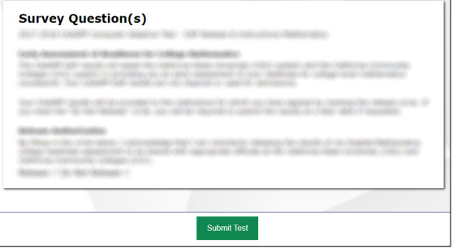
Grade Eleven EAP
Remember, grade eleven students can release their scores to EAP.
Notes:
Grade 11 students will see the screen where they can choose to release their scores to Early Assessment Program or not.

Slide 116
Reminder About Rules for Ending the Test
A student may not return to a segment once it has been completed.
Students may not return to a test once it has been submitted.
Students must enter an answer for all items on a page before proceeding.
During the test, students may mark item for review if they want to return to it, they can do so at the end of the segment or use the past/marked question drop-down list (for Smarter Balanced Assessment and CAST).
Notes:
Reminder about Rules for Ending the Test
A student may not return to a segment once it has been completed.
Students may not return to a test once it has been submitted.
Students must enter an answer for all items on a page before proceeding.
During the test, students may mark item for review if they want to return to it, they can do so at the end of the segment or use the past/marked question drop-down list (for SBAC and CAST).

Slide 117

Security Incidents and Cheating
Notes:
Remember, the assessments within the CAASPP System are secure.
We covered in a previous section, your role in terms of maintaining test security.
In this section we will talk about test security incidents and cheating.

Slide 118

Let Us Discuss How to Handle Cheating
Notes:
Let’s discuss how to handle cheating.
In the case of a student cheating, the TA must stop the cheating and notify the CAASPP test site coordinator.
If the situation involves a breach of test content to social media contact your LEA CAASPP coordinator or CAASPP test site coordinator immediately, they will then submit a STAIRS case using the STAIRS/‌Appeals process.

Slide 119
Types of Security Incident: Breach
Breach
These have external implications.
A breach incident must be reported to your site or LEA coordinator immediately.
Notes:
But what about other types of security issues?
Well, there are three levels:
Breach
Irregularity
Impropriety
Breaches may include such situations as exposure of secure materials or an ongoing security or system risk.
These have external implications.
Examples of a breach are test items shared in social media or a test administrator modifying student answers.
A breach incident must be reported to your site or LEA coordinator immediately.
Our LEA coordinator is [insert name]
They will then report this to ETS.

Slide 120
Types of Security Incident: Irregularity
Breach
Irregularity
These have external implications.
A breach incident must be reported to the LEA coordinator immediately.
These can be contained at the local level.
Take corrective action and notify the site coordinator.
Notes:
An irregularity is an unusual circumstance that impacts an individual or group of students who are testing and may potentially affect student performance on the test or impact test security or test validity.
These circumstances can be contained at the local level.
Examples of irregularities are student(s) who were assigned an incorrect designated support or accommodation, or student(s) who cheated.
For these types, local administrators or staff (that’s you) take corrective action and notify the site coordinator.
The site coordinator will submit a STAIRS case.

Slide 121
Types of Security Incident: Impropriety
Breach
Irregularity
Impropriety
These have external implications.
A breach incident must be reported to the LEA coordinator immediately.
These can be contained at the local level.
Take corrective action and notify the site coordinator.
These have a low impact and low risk.
Take corrective action and notify the site coordinator.
Notes:
An impropriety is an unusual circumstance that has a low impact on the individual or group of students who are testing and has a low risk of potentially affecting student performance on the test or of impacting test security or test validity.
Examples of improprieties during a test session are student(s) making distracting gestures or sounds [e.g., talking] or a disruption such as a fire drill or internet outage.
For these, local administrators or staff take corrective action and notify the site coordinator.

Slide 122
STAIRS Security Test and Incident Reporting System
[Insert information here about your local process.]
Notes:
[talk about your local STAIRS process]

Slide 123

Activity: Show What You Know
Notes:
Ok that was another big chunk of information, so we want to give you some processing time.
This time we are going to play Thumbs Up, Thumbs Down.
I am going to out up a statement. If you agree with it, give me a thumbs up, if you disagree, give me a thumbs down.
Notes for Facilitators:
You will say the statement on the slide.
Ask attendees to mark their answer either on scratch paper or electronically in the resource guide in the activities section.
Reteach as needed based on attendee responses.

Slide 124
Show What You Know #1
Question:
What information in not needed for a student to log on to a test?
SSID:
Student’s Statewide Student Identifier (SSID)
Teacher's name
Student's first name as in CALPADS
Notes:
Let's do a quick check for understanding and show what you know! Respond by showing your answer by holding up the number of fingers for the answer or by writing the number for the answer on a card.
Question: What information is NOT need for a student to logon to a test?
SSID: Student’s Statewide Student Identifier (SSID)
Teacher's name
Student's first name as in CALPADS
The correct response is #2, the name of the teacher is NOT needed to begin a test.

Slide 125
Show What You Know #2
Question:
If a test item is shared on social media, what type of security incident is it?
Irregularity
Impropriety
Breach
Notes:
Here's another opportunity to show what you know.
Again, show the answer by holding up your fingers or a card with the number for your answer.
Question: If a test item is shared on social media, what type of security incident is it?
An irregularity
An impropriety
A breach
The correct answer is #3. This example reflects a breach of test security.
A breach incident must be reported to the LEA coordinator immediately.
They will then report this to ETS.

Slide 126

Preparing Students
Notes:
Let's talk about some ways to help prepare our students for testing.
Facilitator note: This section is optional and may be done as a separate training.

Slide 127


Practice is Important
Gain familiarity
Become comfortable
Use embedded tools
Resources for student practice
Notes:
Practice is an important piece in preparing students and staff for testing.
By utilizing available resources, students and staff gain familiarity with the testing platform, become more comfortable with different item types, and understand how to navigate within the system.
It is good to build familiarity with the testing system prior to summative testing.
Students with designated supports and accommodations can test their utility and learn how to use those embedded tools to ensure fair and valid testing. And practice gives all students the opportunity to become familiar with universal tools.
Practice will reduce the number of system usage errors and security and administration incidents, reduce apprehension of the process, reduce test anxiety in students, and provide for a smoother summative testing experience.
There are resources for student practice that are available to students, teachers, parents, and administrators, so anyone can practice, not just students!

Slide 128

Practice
Tests
Notes:
We are going to start with Practice Tests as resources for student practice.

Slide 129

Practice Test Goal
Format and structure
Experience CAASPP or ELPAC
Scoring guides
Accommodations
Notes:
The goal of the practice tests is to expose students, parents, teachers, and test administrators or examiners to the tests so they may become familiar with the format and structure of a summative assessment.
Practice tests provide students with the opportunity to experience CAASPP or ELPAC at each grade level or grade span tested.
Scoring guides are available for the practice tests, but the tests themselves are not automatically scored, regardless of how they are administered.
The practice and training tests contain embedded universal tools, designated supports, and accommodations that are part of the online test administration system, in order to provide students with a grade-level, subject specific experience of their use.
Also please keep in mind, students can login using their SSID or as a guest to access the practice and training test.

Slide 130

Taking a Practice Test
Students can take a practice or training test at school, or at home in an unmonitored environment.
Notes:
Students can take a practice or training test at school, or at home in an unmonitored environment.
Or the teacher may launch a test session and have students access the test through the secure browser.
By practicing the "log on" and "approval" processes, both the teacher and students gain experience together with the testing platform.
It is best to have the students practice using the secure browser that they will be using during the summative testing.
For the CAAs and Alternate ELPAC, administration is one-on-one using the directions for administration, which we call DFAs.
Again, the practice tests are not scored automatically, but hand scoring is an option, with scoring guides, answer keys, and rubrics available to provide details on test items, student response types, correct responses, and alignment with state standards, making them valuable resources for teachers.

Slide 131
Practice Test Availability
Smarter Balanced for ELA and Mathematics
CAAs for ELA and Mathematics
CAST
CAA for Science
CSA
Summative ELPAC
Summative Alternate ELPAC
Notes:
Practice Tests are available for:
Smarter Balanced Summative Assessments for ELA and math
The California Science Test, or CAST
California Alternate Assessments, or CAAs, for ELA, mathematics, and science
The California Spanish Assessment, or CSA
Summative ELPAC, where there is one per domain for the same grade levels and grade spans as the Summative ELPAC
And the Summative Alternate ELPAC

Slide 132

Interim Assessments
Notes:
The other option is Interim Assessments.

Slide 133

A Note
About Interim Assessments
California Education Code
Copyrighted
Notes:
Before we dive in, we want to mention one last thing about interim assessments.
California Education Code Section 60642.7 (b) prohibits the use of interim assessments for any high stakes purposes such as course placement, identification as gifted or talented, or reclassification of English learners.
Another important note is that the interim assessments are copyrighted, so they may not be posted into third party platforms such as Google Classroom or Canvas.
They may only be used within the systems provided by the CDE.
The Interim Assessments are secure and require a Test Operations Management System, or TOMS, logon to access.
And interims are student and teacher facing only.

Slide 134

Interim Assessment Purpose
Inform and support teaching and learning
Evaluate student knowledge and skills
For and of learning
Offer accessibility resources
Notes:
Let's focus on the purpose of interim assessments.
Interim assessments are free resources which can inform and support teaching and learning in multiple ways.
Their intended purpose is to evaluate student knowledge and skills during the year.
Interim assessments can be used flexibly as both assessments for learning and of learning.
This means that interim assessments can be administered in a standardized manner, as a formal individual assessment, or in a non-standardized manner, which we will discuss more on the next slide.
The interim assessments provide the full range of CAASPP accessibility resources, allowing students to demonstrate their knowledge and abilities using the same tools they regularly use during classroom instruction and summative assessments.
As you review this lesson, think about your own classroom, school, or district and where the interims might fit. Also, consider how you could utilize interim assessments to inform and develop your own classroom assessments.

Slide 135

Administration Options
Any grade level
Standardized way
Nonstandardized way
Flexibility
California Department of Education (CDE) systems
Notes:
The interim assessments may be administered at any grade level to any student.
The interims assessments may be administered in a standardized way, which is administering the interim assessments in the same way the Summative is administered, or the Interims may be administered in a non-standardized way, meaning:
Students might work on test items with other students, such as in pairs or small groups.
The teacher might even lead a whole class lesson while displaying an interim test item like a stand-alone question, a short response question, or a performance task.
This provides educators with the flexibility to use the interim assessments as best suits their instructional needs.
Interim assessment results in the California Educator Reporting System, or CERS, provide item-level information to support teaching and learning.
Also note that interim assessments are copy-righted, so they may not be posted into third-party platforms.
They may only be used within the systems provided by the California Department of Education (CDE).
And interims are student and teacher facing only.
For students attending school remotely, the interims are available for remote administration, without the use of a secure browser.

Slide 136
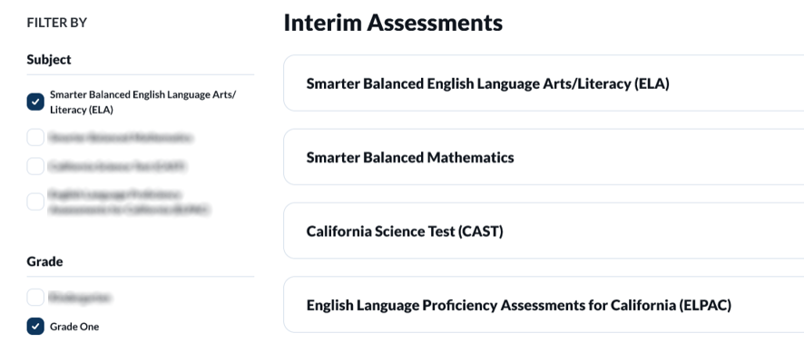
Interim Assessment Lookup Tool
Notes:
Interim assessments are available all year long, however, the new interim assessments for the school year usually rollover in late summer.
There is a web page that lists all the interim assessments that are available, The Interim Assessment Lookup Tool, so we don’t have to list them all here.
The links for the IA Lookup Tool web page is in the resource guide.
We also want to note that all interim assessments are administered on the computer but are NOT computer-adaptive.
They include a fixed set of items, and every student gets the same items.
There is one exception to the computer-based setup, which we will mention on the ELPAC slide.
And lastly, some interim assessments contain items that require hand scoring.
The new web page will list how many hand scoring items are required for each interim assessment.
This information is important to know because when an assessment has a hand-scored item, the item will need to be scored locally and submitted before the assessment results will display in CERS.

Slide 137

Smarter Balanced
Interim Assessments
Interim Comprehensive Assessments (ICAs)
Interim
Assessment
Blocks (IABs)
Focused
Interim Assessment Blocks (FIABs)
Notes:
Since there isn’t time to list all the interim assessments, let’s dig into how they are organized.
For Smarter Balanced for ELA and math they are organized by the content they assess.
The Interim Comprehensive Assessments (ICAs) test the same content and report scores on the same scale as the summative assessments.
With the Smarter Balanced adjusted form assessments, the ICAs will actually take longer than the summative to administer as they align more with the full-form summative assessment blueprint.
They can be administered up to three times a year.
Each ICA includes one or more items that require hand scoring.
Interim Assessment Blocks (IABs) focus on smaller sets of related concepts and provide more detailed information for instructional purposes.
They generally have from 6 to 18 items and can be administered within one class period.
They could be administered an unlimited number of times, but it is important to note that there is currently only one form for each IAB so students would experience the same items if the assessment is given more than one time.
Focused IABs (FIABs) assess even smaller “chunks” of content - generally 1 to 3 assessment targets.
They generally have 10-15 items focused on very specific concepts.

Slide 138




CAST Interim Assessments
Elementary School
Middle
School
High
School
Grade three
Earth and Space
Earth and Space
Grade four
Life
Life
Grade five
Physical
Physical
Notes:
CAST Interim Assessments are organized in two ways.
In elementary, they are organized by grade level performance expectations, so the CAST IAs for grades 3, 4, and 5 assess all three science domains (Earth and Space Sciences, Life Sciences, and Physical Sciences)
In middle school and in high school, the CAST Interim Assessments are organized by science domains, so there are three middle school and three high school CAST Interim Assessments, and they each assess one science domain.
Each interim will include one performance task with a constructed response that will require hand scoring.

Slide 139
ELPAC Interim Assessments
Listening
Grade Levels and Spans | Kindergarten | 1 | 2 |  | 3–5 | 6–8 | 9 and 10 | 11 and 12
Speaking
Grade Levels and Spans | Kindergarten | 1 | 2 | 3–5 | 6–8 | 9 and 10 | 11 and 12
Reading
Grade Levels and Spans | Kindergarten | 1 | 2 | 3–5 | 6–8 | 9 and 10 | 11 and 12
Writing
Grade Levels and Spans | Kindergarten | 1 | 2 | 3–5 | 6–8 | 9 and 10 | 11 and 12
Notes:
ELPAC Interim Assessments are organized by domain and grade level or grade span.
The ELPAC has an interim assessment for each domain:
Listening,
Speaking,
Reading and
Writing
For the following grade levels and spans:
Kindergarten
grade one
grade two
grade spans
three through five
six through eight
nine and ten
and eleven and twelve.
Speaking and Writing are locally hand scored by educators;
Reading and Listening are computer scored.
The ELPAC Interim Assessments will be administered online to students as a linear test, except for kindergarten through grade two Writing domain, which, like the Summative ELPAC, will be administered on paper.
Each interim will include about half the items on the Summative ELPAC, with all Summative task types covered between Interim 1 and Interim 2.
This means there are two forms, or two versions available for each interim assessment.

Slide 140

Interim Assessment Results in CERS
Item viewer
Item information
Key/Distractor Analysis
Rubric and exemplar
Student responses to items
Links to instructional resources
Notes:
[hide this slide if you do not roster students to teachers in CERS]
For all interim assessments, we get the following data in CERS, or the California Educator Reporting System:
The grade level assessed
Average Score for the group
Number of students in the results
Student score distribution by level
Individual student results
However, we also get additional information which is specific only to the interim assessments, such as:
Item viewer
Item information for example, standard, claim, and depth of knowledge
A Key/Distractor Analysis, which shows an answer key that displays the number or percent of students that have chosen each answer choice
Rubric and exemplar information
Student responses to items; and
Links to instructional resources for the smarter balanced IABs and focused IABs

Slide 141
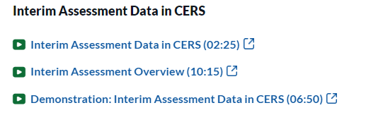
CERS Microlearning Videos
All training videos can be found on the
CAASPP and ELPAC Upcoming and On-Demand Trainings web page.
Notes:
[hide this slide if you do not roster students to teachers in CERS]
Lastly, we want to call out the that training on how to access this data in CERS was recorded as a series of microlearning videos, so you can watch the whole thing OR access just the parts you want.
These can be found on the Upcoming and On Demand Trainings page of the CAASPP & ELPAC Website.

Slide 142

Thank you for attending!

