Slide 1






ELPAC Test Examiner Training Deck
Notes:
This is the English Language Proficiency Assessments for California (ELPAC) Test Examiner Training Deck.

Slide 2
How Local Educational Agencies Can Use This Deck
Review the content in the deck.
  Highlighted text on the slide denotes something you may need to change based on your local procedures.
  [Bracketed bold and italic text in speaker notes denotes something you may need to update based on your local procedures.]
Make the deck your own.
  Hide or add any slides, as needed, for your local training.
  You can add district or school logos and change the colors as needed.
  Many slide titles have a (2) after them. Those were needed to post the deck accessibly, but you can remove them for your live presentation if you prefer.
  Insert the break slide (next slide) where needed for your flow.
Notes:
How can local educational agencies use this deck?
Review the content in the deck.
Highlighted text on the slide denotes something you may need to change based on your local procedures.
Bracketed bold and italic text in speaker notes denotes something you may need to update based on your local procedures.
Make the deck your own.
Hide or add any slides, as needed, for your local training.
You can add district or school logos and change the colors as needed.
Many slide titles have a (2) after them. Those were needed to post the deck accessibly, but you can remove them for your live presentation if you prefer.
Insert the break slide (next slide) where needed for your flow.

Slide 3
How Local Educational Agencies Can Use This Deck (2)
Following adult learning best practices, there are multiple reflection points or activities throughout the training.
  We highly recommend you leave these in. For optimal learning, adult learners need to engage in one activity or reflection for every 12–18 minutes of content.
Please note a couple of details about this deck.
  It is intended for training test examiners, but there is some information for test examiners which might be useful.
  Some screenshot images are blurred to highlight important areas and for accessibility.
Notes:
Please note, following adult learning best practices there are multiple reflection points or activities throughout the training.
We highly recommend you leave these in. For optimal learning, adult learners need to engage in one activity or reflection for every 12–18 minutes of content.
Please note a couple of details about this deck.
It is intended for training test examiners, but there is some information for test examiners which might be useful.
Some screenshot images are blurred to highlight important areas and for accessibility.

Slide 4

Break Time
Notes:
Insert this “Break Time” slide as needed once you have the flow of your training.

Slide 5
ELPAC Test Examiner Training
Notes:
Welcome, everyone, to the ELPAC Test Examiner Training!

Slide 6

Agenda
Overview of English Language Proficiency Assessments for California (ELPAC)
Test Security
Accessibility Resources Overview
Different ELPAC Roles
ELPAC Prep
Classroom Logistics for Starting a Test Session
During ELPAC Testing
ELPAC Pause Rules
After ELPAC Testing
Technology: Test Administration
Security Incidents and Cheating
Preparing Students
Notes:
Today we will cover
an overview of English Language Proficiency Assessments for California, or ELPAC;
Test Security;
Accessibility Resources Overview;
Different ELPAC Roles;
ELPAC Prep;
Classroom Logistica for Starting a Test Session;
During ELPAC Testing;
ELPAC Pause Rules;
After ELPAC Testing;
Technology: Test Administration;
Security Incidents and Cheating; and
Preparing Students.

Slide 7

ELPAC Overview
ELPAC Umbrella
Initial ELPAC
Initial Alternate ELPAC
Summative ELPAC
Summative Alternate ELPAC
Notes:
Let's start with an overview of the ELPAC.
As a reminder, ELPAC stands for the English Language Proficiency Assessments for California.
The following assessments are Under the ELPAC umbrella, as we like to say:
Initial ELPAC
Initial Alternate ELPAC
Summative ELPAC
Summative Alternate ELPAC
Let's dig into each assessment a bit more.

Slide 8
Initial ELPAC
Who?
Students in kindergarten (K) through grade twelve whose Home Language Survey indicates a primary language other than English
How?
K through grade two: Computer-based administered one-on-one, except Writing, which is administered via paper-pencil individually or may be administered in small groups
Grades three through twelve: Computer-based for all domains and administered in groups, except Speaking, which is assessed one-on-one
When?
Within 30 calendar days of student’s first day
Begins first week of July through June 30, annually
Notes:
Let's begin with who takes the Initial ELPAC?
The answer is all students in kindergarten, or K, through grade twelve whose Home Language Survey indicates a primary language other than English.
How is the ELPAC administered?
The Initial ELPAC is an untimed computer-based assessment for all grade levels, except K through grade two writing, which is a paper-pencil test administered one-on-one.
K through grade two Speaking, Listening, and Reading are administered one on one, but the Writing may be given in small groups.
Grades three through twelve are administered in groups except for speaking, which is assessed one-on-one.
When?
The Initial ELPAC administration window is open from first week of July through June 30 annually. The test must be administered within 30 calendar days of the student’s first day of instruction in a California public school
Resource guide:
https://www.caaspp-elpac.org/s/docs/inelpacfactsheet.pdf

Slide 9
Summative ELPAC
Who?
Students in K through grade twelve who were previously identified as English learner (EL) students based on their initial assessment results
How?
K through grade two: Computer-based administered one-on-one, except Writing, which is administered via paper-pencil individually or may be administered in small groups
Grades three through twelve: Computer-based for all domains and administered in groups, except Speaking, which is assessed one-on-one
When?
The Summative ELPAC administration window typically opens February 1 through May 31, annually
Notes:
Who takes the Summative ELPAC?
All K through grade twelve students who have previously been identified as English learner, or EL, students based upon their initial assessment results. The Summative ELPAC measures how well they are progressing in English language proficiency
How is the test administered?
The Summative ELPAC is an untimed computer-based assessment for all grade levels, except K through grade two writing, which is a paper-pencil test administered one-on-one.
K through grade two Speaking, Listening, and Reading are administered one on one, but the Writing may be given in small groups.
Grades three through twelve are administered in groups except for speaking, which is assessed one-on-one.
When?
The Summative ELPAC administration window is typically open annually from February 1 through May 31.
Resource Guide:
https://www.caaspp-elpac.org/s/docs/suelpacfactsheet.pdf

Slide 10
Initial and Summative Alternate ELPAC
Initial: Students in K through grade twelve whose Home Language Survey indicates a primary language other than English and who have the most significant cognitive disabilities
Summative: Students in K through grade twelve who were previously identified as EL students based on their initial assessment results with the most significant cognitive disabilities
How
  Administered one-on-one for students in K through grade twelve
When
  Initial Alternate ELPAC
    Testing window: first week of July through June 30
  Summative Alternate ELPAC
    Testing window: typically, February 1 through May 31
Notes:
Who takes the Initial and Summative Alternate ELPAC?
The Initial Alternate ELPAC is designed for students in K through grade twelve whose Home Language Survey indicates a primary language other than English and who have the most significant cognitive disabilities
The Summative Alternate ELPAC is designed for students in K through grade twelve who were previously identified as EL students based on their initial assessment results with the most significant cognitive disabilities who are EL students and whose individualized education program, or IEP, teams have determined that they are eligible for an alternate assessment.
How? Administered one-on-one for students in K through grade twelve
When? The Initial Alternate ELPAC testing window is from the first week of July through June 30
The Summative Alternate ELPAC testing window is typically February 1 through May 31
Resource Guide:
https://www.caaspp-elpac.org/s/docs/inaltelpacfactsheet.pdf
https://www.caaspp-elpac.org/s/docs/altelpacfactsheet.pdf

Slide 11

Participation Rate Expectation
Notes:
First up is the participation rate expectation.
While the Title I requirement is testing 100 percent of eligible students, to ensure that districts, County Offices of Education, and schools are testing all current English Learner students, they must meet or exceed a participation rate of 95 percent on the Summative ELPAC and Summative Alternate ELPAC to avoid accountability penalties on the Dashboard.
This Resource is a useful tool for understanding Participation Rate: ELPAC Participation Rate in the ELPI

Slide 12

ELPAC Testing Times
Estimated testing times can be found on the CAASPP & ELPAC Website for the following assessments:
Initial ELPAC
Summative ELPAC
Initial Alternate ELPAC
Summative Alternate ELPAC
Notes:
Estimated testing times can be found on the CAASPP & ELPAC Website for the following assessments:
Initial ELPAC
Summative ELPAC
Initial Alternate ELPAC
Summative Alternate English Language Proficiency Assessments for California (ELPAC)
The links to the web pages where these times are listed can be found in the resource guide.

Slide 13

Test Security
Notes:
Next up, we want to cover test security.

Slide 14

Test Operations Management System (TOMS) Security Affidavits
Notes:
Each year, when you are assigned a role in the Test Operations Management System, or TOMS, you will be required to annually sign a test security affidavit when you log on to TOMS for the first time.
This is a very important step—one you must do before you start testing.
The Test Security Affidavit states that the signer will follow each of the listed items to safeguard the assessments as well as administer them in manners that match the directions for assessments.
Please be sure to read through the form each year.
After signing the Security Affidavit, users will get access to all assessments in about an hour.
Best practice is to ensure users have signed the day before.

Slide 15

ELPAC Test Security Affidavit for Non-TOMS Users
Notes:
Users who do not require access to TOMS but have access to ELPAC secure testing materials (including student score reports), must also sign the ELPAC Test Security Affidavit for Non-TOMS Users form every year.
This form can be found on the Test Security web page. The link is in your resource guide.
We want you to do a quick reflection on who may need to sign this form.
Think about your classrooms and your school as a whole.
[Pause for reflection. Popcorn around the room to get shared answers.]
Examples: the custodians, teachers’ aides, office staff

Slide 16

Secure Browser
Notes:
Another security reminder is about the secure browser required for testing.
[Insert how your IT department will get the browser on devices, or the date by which this will be done.]
Prior to administering the computer-based assessments, please check all devices that will be used and close all applications except those identified as necessary by the school technology coordinator.
After closing these applications, you should open the secure browser on each device.
The secure browser and Student Interface automatically detect certain applications that are prohibited from running on a device while the secure browser is open.
The secure browser will not allow a student to log on if the secure browser detects that a forbidden application is running on the device.
A message will also display that lists the forbidden application(s) that needs to be closed.

Slide 17

ELPAC Secure
Materials
Notes:
Remember that ELPAC administration materials are considered secure materials. This means that these printed and electronic materials must be securely stored at all times and securely destroyed as well.
Some examples of these materials for ELPAC include Directions for Administration (DFAs), specific grade level writing books and answer books, braille and large print test books, paper-pencil materials, Examiners Manuals, Audio Scripts, Picture Cards, Test Item Preview booklets (TIPS), and Picture cards. Other secure administration materials include Student Rosters and unused pre-identification labels.
For securely handling electronic materials:
You must be sure to securely delete these files from the location on which it was stored on your devices. Users should confirm that the files are also removed from all places on the device, including a Downloaded folder and any cloud storage or recycle bin where the file could be undeleted.
Students may use scratch paper to make notes or develop draft responses during the ELPAC. To maintain the security of scratch paper:
Collect and inventory the scratch paper at the end of each test session as well as upon completion of the assessment.
Do not keep printed test items or passages or scratch paper for future test sessions.
At the end of the test session for the day or completion of the assessment, TEs should collect the logon tickets issued to students and securely destroy them.
A Speaking Student Score Sheet should be destroyed securely after a student’s responses have been entered into the DEI.
Resource Guide:
Handling Secure Materials section of the ELPAC OTAM: https://ca-toms-help.ets.org/elpac-otam/test-security/handling-secure-materials/

Slide 18

Activity: Pop Quiz
Notes:
Quiz time!
We are going to do a pop quiz activity to check for understanding.
Please get out a piece of paper and number it one through three or complete this electronically in your resource guide.
Here we go:
Notes for Facilitators:
Ask the question using the question slide.
Ask attendees to jot down their answer
Share the answer with the answer slide
Ask who got it right
Reteach info where needed

Slide 19
Question #1
Question: True or False?
Eligible EL students must be administered either Summative ELPAC or Summative Alternate ELPAC.
Notes:
On to question #1: True or False?
Eligible EL students must be administered either the Summative ELPAC or Summative Alternate ELPAC.
[Ask attendees to jot down their answers. Once all attendees have answered on a piece of paper, go to the next slide.]

Slide 20
Answer #1
Question: True or False?
Eligible EL students
must be administered either Summative ELPAC or Summative Alternate ELPAC.
Answer: True
The state expects all eligible
EL students to be tested annually
until reclassified.
Notes:
The answer to this one is True.
The state expects all eligible EL students to be tested annually either with Summative ELPAC or Summative Alternate ELPAC until reclassified.
[Review more if needed.]

Slide 21
Question #2
Question: True or False?
Scratch paper can be secured between test sessions and returned to the student to use over multiple days.
Notes:
On to question #2: True or False?
Scratch paper can be secured between test sessions and returned to the student to use over multiple days.
[Ask attendees to jot down their answers. Once all attendees have answered on a piece of paper, go to the next slide.]

Slide 22
Answer #2
Question: True or False?
Scratch paper can be secured between test sessions and
returned to the student to use over multiple days.
Answer: False
False for ELPAC and Alternate ELPAC; it must be collected at the end of each test session and securely destroyed.
Notes:
The answer to this one is False
Do not keep scratch paper for future sessions. All scratch paper used during ELPAC assessments (all domains) must be collected when the test session has ended and securely destroyed or electronically erased. Be sure to erase it from the recycle bin on the device as well.
[Review more if needed.]

Slide 23
Question #3
Question: True or False?
Only 95 percent of eligible EL students must be tested annually.
Notes:
And finally, Question #3: True or False?
Only 95 percent of eligible EL students must be tested annually.
[ask attendees to jot down their answers]
[once all attendees have answered on a piece of paper go to next slide]

Slide 24
Answer #3
Question: True or False?
Only 95 percent of eligible EL students must be tested annually.
Answer: False!
The Summative ELPAC and Summative Alternate ELPAC participation rate expectation is 100 percent of eligible students.
Notes:
This one was a bit tricky, but the answer is false.
Only 95% percent of eligible EL students must be tested annually.
The Summative ELPAC and Summative Alternate ELPAC participation rate expectation is 100 percent of eligible students.
[Review more if needed.]

Slide 25

Accessibility Resources Overview
Notes:
Our next section an overview of accessibility resources.

Slide 26


Equality Does Not Mean Equity
Provide all kids with the exact bike they need, either in size or structure, and they are all able to enjoy the full benefits of the activity.
Notes:
In the past, we often talked about equality in education—providing each student with the same educational opportunities.
Now, we are focused on equitable education—providing each student with the tools and resources they need to be successful in school and to graduate ready for college and career. Those needs can vary greatly by individual students.
Here is another way to think about it.
For equality, imagine four bicyclists that all have the same bike.
They have ‘equal’ equipment.
The problem is that one cyclist uses a wheelchair, one is very tall and on a bike that seems too small, one is using a bike that looks like a perfect size, and the last one is a small cyclist trying to ride a bike that is much too big. ​
So instead, let's imagine equity.
With equity, each cyclist is provided a bike that meets their needs;
the cyclist in a wheelchair is provided a modified bike;
the tall cyclist is equipped with a larger bike;
the cyclist who had the bike that was perfectly sized is still riding this bike; and
the small cyclist is fitted with a bike that is appropriately sized.
In this example, equity means each cyclist is provided with the exact bike they need, either in size or structure, so they are all able to enjoy the full benefits of the activity and have the correct equipment they need to perform successfully.​
Equity also relates to assessments, as some students need something entirely different to help them achieve their goals.

Slide 27

1-2-3-4s of Accessibility—#1
1-2-3-4s of Accessibility: 1
One Purpose:
Access
Notes:
Let’s cover the 1-2-3-4s of accessibility.
We have one purpose when it comes to accessibility—access.
Students with specific learning needs may require accessibility resources to fully engage and demonstrate mastery of content during instruction and on assessments.
To better serve them, there are a wide range of resources available for ELPAC.
These resources ensure that the administration of the test meets the needs of all students, including those with disabilities.

Slide 28
1-2-3-4s of Accessibility: 2
One Purpose:
Access
Two Options:
Embedded
Non-Embedded
Notes:
When it comes to the delivery of accessibility resources there are two options: embedded and non-embedded.
Embedded resources are digitally delivered as part of the technology platform for the computer-based tests such as strikethrough.
Non-embedded resources are provided by the local educational agency, or LEA, outside of the test delivery system such as scratch paper.

Slide 29
1-2-3-4s of Accessibility: 3
One Purpose:
Access
Two Options:
Embedded
Non-Embedded
Three Categories:
Engagement
Presentation
Action and Expression
Notes:
ELPAC Accessibility resources fall into three categories, based on the universal design for learning.
There are resources that support students to remain engaged with the assessment. For example, providing breaks, a separate setting, or noise buffers.
There are resources that support students by varying the way the assessment is presented. For example, the Streamline designated support presents the assessment in a simplified format in which the items are displayed below the stimuli vertically.
And finally, there are resources that support students by allowing them to respond through various actions and expressions. For example, Alternate Response Options, which may involve an adaptive keyboard or an augmentative and alternative communication, or AAC, device.

Slide 30
1-2-3-4s of Accessibility: 4
One Purpose:
Access
Two Options:
Embedded
Non-Embedded
Three Categories:
Engagement
Presentation
Action and Expression
Four Types:
Universal Tools
Designated Supports
Accommodations
Unlisted Resources
Notes:
And there are four types of resources.
Universal Tools are available to all students, based on individual choice and preference.
You do not have to do anything to turn on a Universal Tool, they come built into the test. Examples include zoom, notepad, highlighter, and strikethrough.
There are some non-embedded universal tools that you may have to provide, such as scratch paper.
Next are the Designated Supports.
They are available to any student when determined for use by an educator or team of educators (with parent/guardian and student input, as appropriate) or specified in the student’s individualized education program, or IEP, or Section 504 plan.
The determination of assigning designated supports should be decided on a student-by-student basis. Any assigned designated support should be one the student uses in daily instruction, assessment, or both.
Students do not need an IEP or Section 504 plan to get designated supports.
Designated supports include things like translated test directions or text-to-speech.
The next are Accommodations.
For accommodations, the student is required to have an active IEP or Section 504 Plan, and the accommodation must be written into the IEP or Section 504 Plan and designated on the Statewide Testing page of the IEP or Section 504 Plan.
Accommodations are things like American Sign Language (ASL), Braille, or Alternate Response Options.
I am going to pause here before we move onto the fourth type.
For the three types listed so far—universal tools, designated supports, and accommodations—students who use these during the test will still get a valid test score.
These resources do not change the construct of what is being measured.
The fourth type is Unlisted Resources.
The student needs an IEP or active 504 Plan to be able to request these unlisted resources, and there is a process for requesting them.
Unlisted resources are resources that are not already identified in the California Assessments Accessibility Resources Matrix.
For a student to access an unlisted resource, the test site coordinator must submit a request to the California Department of Education through the Test Operations Management System, or TOMS, a minimum of ten business days before the student’s first day of testing.
The CDE will review the item and determine if the construct being measured is changed with the use of this resource.
If the construct has not changed, the student will get a valid score.
If the resource will change the construct the student will receive the Lowest Obtainable Scale Score for that domain or alternate test.

Slide 31

California Assessment Accessibility Resources Matrix
Notes:
The California Assessment Accessibility Resources Matrix contains all Universal Tools, Designated Supports, and Accommodations for ELPAC and CAASPP.
The Matrix is your one-stop-shop for information about accessibility resources for these assessments.
The link has been placed in your resource guide.
This document is a great resource, and we recommend that you always keep a copy handy.
The Matrix and other Accessibility Resources are available on the CAASPP-ELPAC Accessibility Resources web page.

Slide 32
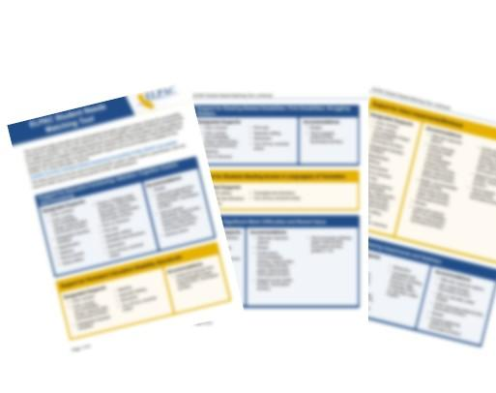
ELPAC Student Needs Matching Tool
Notes:
There is also a resource called the ELPAC Student Needs Matching Tool. This document helps educators and IEP teams choose the accessibility resources for students to use in the classroom and on the ELPAC.
A link to these resources is also included in your resource guide.
Resource Link:
https://www.caaspp-elpac.org/s/docs/elpacmatchingtool.pdf

Slide 33

Accessibility Resources: Our Local Process
Insert local process steps for assigning supports here.
Insert local process steps for assigning supports here.
Insert local process steps for assigning supports here.
Insert local process steps for assigning supports here.
Notes:
[Discuss your local process for assigning and uploading accessibility resources.]

Slide 34

Activity: Case Study
Notes:
We are going to do another activity—this time a classification of resources case study—to practice with accessibility resources.
Notes for Facilitators:
If you are doing this virtually, the links to the graphics are in the resource guide, and the grid will be in the resource guide as well.
If you want to do this on paper, you will need to print the grid from the resource guide and print the Accessibility Resources Graphics for attendees.

Slide 35



Accessibility Resources Case Studies
Lilia—grade five:
EL student
Jamie—grade four: struggling reader
Sarah—grade seven:
attention difficulties
Notes:
Together as a table, you will discuss the needs of three students: Lilia, a grade five EL student; Jamie, a grade four student who is a struggling reader; and Sarah, a grade seven student with attention difficulties. Read the case studies and decide which accessibility resources to assign.
This grid is can be found in your resource guide (or printed if you chose to print it).
[Give them five minutes to work on the sheet. Popcorn around the room to get answers, correct understanding if needed. Discuss things such as being literate in the student’s primary language and translations versus not being literate so translations add to the cognitive load.]

Slide 36
Pause and Reflect
Three key concepts learned
3
3
Two questions to explore
2
2
One strategy or thing to do
1
1
Notes:
The 3-2-1 Prompt: Ask participants to write down three key concepts they learned, two questions they want to explore further, and one strategy or thing to do.
[Give attendees three to four minutes to complete the reflection.]
Notes for Facilitators:
This can be done on scratch paper, electronically, or you can print a reflection document if you choose.

Slide 37

Different Roles
Notes:
We want to briefly cover the different roles available for ELPAC before we jump into your responsibilities before, during, and after testing.

Slide 38
Test Examiner (TE) for ELPAC Versus Alt ELPAC
ELPAC
Local educational agency (LEA) employee
Confirms test settings
Ensures session security
Accesses completion status reports in TOMS
Entry of data and scores into the Teacher Hand Scoring System
Enters student responses and scores into the Data Entry Interface (DEI)
Accesses assessment results in California Educator Reporting System (CERS) [once rostered]
Security affidavit required
Alternate ELPAC
Credentialed or licensed LEA employee who knows and works with the student regularly, and is familiar with the
student's communication modes
Confirms test settings
Ensures session security
Accesses completion status reports in TOMS
Accesses assessment results in CERS [once rostered]
Security affidavit required
Notes:
Let’s compare the role of Test Examiner, or TE, for ELPAC versus TE for Alt ELPAC.
The role of a TE for both the ELPAC and the Alternate ELPAC shares many core responsibilities and requirements.
In both cases, the TE must be a credentialed or licensed employee of the local educational agency, or LEA, who is authorized to administer the appropriate assessment.
They are responsible for confirming that all test settings are correctly established before testing begins and for always ensuring the security and integrity of the testing session.
Additionally, TEs for both assessments have access to completion status reports in TOMS, allowing them to monitor student progress, and they can view assessment results in CERS once students are properly rostered.
A signed security affidavit is also required in both roles, reinforcing the importance of maintaining confidentiality and adhering to standardized testing protocols.
Additionally, TEs are responsible for entry of data and scored into the THSS, when applicable, and entry of student responses and scores into the DEI.
What are the main differences?
The primary difference between a TE for the ELPAC and one for the Alt ELPAC lies in the required relationship with the student and the nature of the administration. While both must be trained employees or contractors of an LEA who are proficient in English, the Alt ELPAC TE should ideally be an educator familiar with the student's daily communication needs due to the assessment's one-on-one, highly individualized nature.

Slide 39

ELPAC Training Requirements
LEA ELPAC coordinators and TEs must complete Administration and Scoring Training (AST) Moodle courses.
List local training requirements here.
Notes:
To prepare for the ELPAC, or Alternate ELPAC, LEA ELPAC coordinators and TEs must complete Administration and Scoring Training, or AST, Moodle courses.
[Cover what is required for your LEA.]

Slide 40

Preparing for ELPAC
Notes:
Now that we have that background information, let’s dig into your TE role as we prepare for the opening of the ELPAC testing window.

Slide 41

Preparing for Administration (PFA) Documents and Directions for Administration (DFAs)
Make sure you have PFA documents and DFAs as needed.
PFA documents are not secure.
DFAs are secure and found in TOMS.
Notes:
Make sure you have the Preparing for Administration, or PFA, documents and/or the Directions for Administration, or DFAs, before testing begins.
PFA documents for ELPAC are found on the Administer a Test Session web page and are not secure.
Teachers can use the electronic PFA documents or print them for use during test administration.
DFAs are secure documents and are found in TOMS as well.
As a reminder, to ensure that all students are tested under the same conditions, the TE should adhere strictly to the DFAs for a particular assessment unless a student is assigned the non-embedded designated support for simplified test directions.

Slide 42
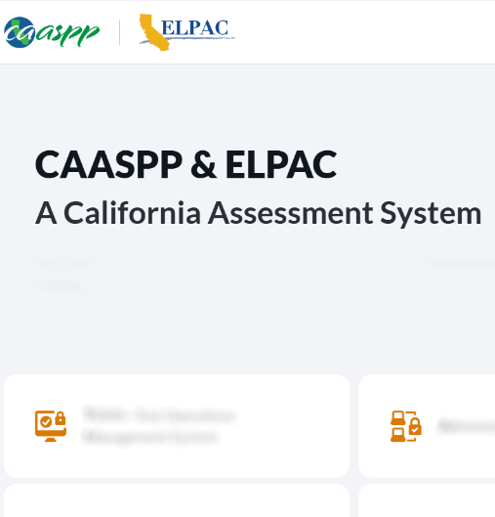
ELPAC Security Affidavit
Log on to TOMS to read and sign the ELPAC Security Affidavit:
Navigate to the CAASPPP & ELPAC Website.
Select the TOMS tile on the home page.
Log on to TOMS.
The first time you log on, you will be asked to read and sign the security forms required for your role.
  This must be done before you start testing, otherwise you will not be able to access the test session!
Notes:
We will start with the before testing steps.
The first thing on the list is to log on to TOMS and complete the appropriate Security Affidavit, as noted in the Security section earlier in this presentation.
This must be done before you start a test session.
You will have to verify your account via email and check your junk folders if you do not receive the verification code in your inbox.
Log on to TOMS to read and sign the ELPAC Security Affidavit:
Navigate to the CAASPPP & ELPAC Website.
Select the TOMS tile on the home page.
Log on to TOMS.
The first time you log on, you will be asked to read and sign the security forms required for your role.
This must be done before you start testing, otherwise you will not be able to access the test session!

Slide 43
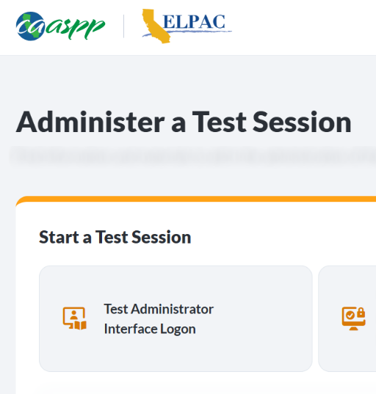
Test Administrator Interface
Make sure you can log on to the
Test Administrator Interface and access ELPAC online assessments:
Navigate to the CAASPP & ELPAC Website.
Select the Administer a Test Session tile on the home page.
Select the Test Administrator Interface Logon button.
Log on to the Test Administrator Interface.
Notes:
Also, before testing, make sure that you can log on to the Test Administrator Interface.
The Test Administrator Interface is used to access all ELPAC online assessments.
Make sure you can log on to the Test Administrator Interface and access ELPAC online assessments:
Navigate to the CAASPP & ELPAC Website.
Select the Administer a Test Session tile on the home page.
Select the Test Administrator Interface Logon button.
Log on to the Test Administrator Interface.

Slide 44

Test Settings
Review student information in TOMS to verify students test settings and Accessibility Resource assignment.
List steps for what to do if the information is wrong for a student.
Notes:
The next step in prepping to give the assessment is to review student information in TOMS to verify the appropriate test settings (for example, masking) in the student’s profile in TOMS at least two hours prior to the test administration.
Domain exemption test assignments must also be set in TOMS if they are designated in a student’s IEP.
Note: If the IEP team identifies text-to-speech (TTS) for a student:
it is not necessary for the Listening, Speaking, and Writing domains as the test is designed to read all questions and answer options aloud.
TTS is not allowable for the Reading domain.
If desired, set up any additional accessibility resources (for example, large mouse cursor).
[List steps for what to do if the information is wrong for a student.]
If a student is assigned "separate setting" for testing, work with [insert name here] to arrange testing for this student.

Slide 45

Test Room Prep
Prepare your testing room.
Cover or take down all displayed instructional materials like vocabulary charts and sentence frame anchor charts.
Arrange student seats so that they cannot view each other’s answers.
Post “Testing—Do Not Disturb” signs outside of the testing room.
Discuss local protocol for phones and other devices during testing.
Notes:
Now let's think about preparing your room for testing.
To do this, you will want to
cover or take down all displayed instructional materials like vocabulary charts and sentence frame anchor charts;
arrange student seats so that they cannot view each other's answers;
post “Testing—Do Not Disturb" and "Unauthorized Electronic Devices May Not Be Used at Any Time During the Testing Session" signs outside your room—the link to these is in your resource guide; and
discuss local protocol for phones and other devices during testing.
Resource:
Other Testing Resources Web Link

Slide 46

Test Room Prep (2)
Designate a place for backpacks, phones, and other devices.
Clear the room of any
non-secure people:
Only testing staff and students who are actively testing should be in the testing room.
Any adult in the room must have signed a security agreement (through TOMS or a non-TOMS agreement).
Notes:
Up next for room prep is to designate a place for backpacks and phones, and other devices.
[Talk through any local procedures on this.]
And you will need to clear the room of any non-secure people so testing can begin.
What do we mean by non-secure people?
Only testing staff and students who are actively testing should be in the testing room.
Any adult in the room must have signed a security agreement (through TOMS or a non-TOMS agreement)
Unauthorized staff or other adults, including students’ parents or guardians, must not be in the room during testing.

Slide 47

Test Materials
Pick up testing materials from secure storage:
Blank scratch paper
Student logon information (SSID, name)—remember, this is secure information
Printed items can be picked up from [insert local procedure]
Notes:
Now that our rooms are ready, we want to gather the supplies needed for testing. This includes
blank scratch paper; and
student logon information (such as SSID and name). Remember, this is secure information.
When print-on-demand is allowed, students will send print request to a secured printer and then TE will give to the student. It does not pre-print the test.
Also, if you have any printed materials or forms, you will pick those up from [insert local procedure for this.]

Slide 48

Activity: Thumbs Up, Thumbs Down
Notes:
Let's take a moment to check in on what we just covered about ELPAC roles and preparing to administer the assessments with a Thumbs Up, Thumbs Down activity.
I am going to offer out a statement. If you agree with it, give me a thumbs up, if you disagree, give me a thumbs down.
Notes for Facilitators:
You will say the statement on the slide.
If attendees agree they will give a thumbs up, if they disagree, a thumbs down.
Reteach as needed based on attendee responses.

Slide 49
Statement #1
Thumbs up or thumbs down?
You need to log on to TOMS before you can start a test session.
Notes:
Statement number one: You need to log on to TOMS before you can start a test session.
[Wait to see how attendees respond.]
This is a thumbs up.
You need to log on to TOMS before testing to sign the security affidavit.
If you do not do this, you will not be able to start a summative test session.
This is not something you want to run into while you have a classroom full of students waiting for you to start the test session, so please be sure to get this completed before you get near testing time.

Slide 50
Statement #2
Thumbs up or thumbs down?
You can leave instructional materials on your walls uncovered during testing.
Notes:
Statement number two: You can leave instructional materials on your walls uncovered during testing.
[Wait to see how attendees respond.]
This is a thumbs down.
You need to remove or cover all instructional materials during testing.

Slide 51
Statement #3
Thumbs up or thumbs down?
My school or LEA has a local protocol for electronic devices (such as phones or smartwatches) during testing.
Notes:
Let’s do one more. Statement number three: My school or LEA has a local protocol for electronic devices (such as phones or smartwatches) during testing.
[Wait to see how attendees respond.]
This is a thumbs up.
To ensure that all students are tested under the same conditions and test security, your school or LEA should have a local protocol for electronic devices (such as phones or smartwatches) during testing.
If thumbs down, your school or LEA doesn't have a plan, how can you work to maintain a secure testing environment?

Slide 52

Classroom Logistics for Starting a Test Session
Notes:
Now let’s discuss classroom logistics for starting a test session.

Slide 53

Create an Appropriate Test Environment
Start a testing session and write the Session ID on the board.
Provide a quiet environment void of talking or other distractions that might interfere with a student’s ability to concentrate or might compromise the testing situation or environment.
Notes:
This next section is all about starting a test session.
Before we jump in, I want to let you know that we will cover later in this training the steps you will follow to start a test session.
First up, for your role is to start a testing session and write the Session ID on the board.
Students will need this ID to log on to the test.
You will also want to ensure you create an appropriate test environment void of talking or other distractions that might interfere with a student’s ability to concentrate or might compromise the testing situation or environment.
Resource guide:
https://ca-toms-help.ets.org/s/pdf/How-to-Start-an-ELPAC-Test-Session.pdf

Slide 54

Verify Student Test Settings
Review student information in the Test Administrator Interface to verify test settings as you let students into the Test Session.
List steps for what to do if the information is wrong for a student.
Read the “Say” lines in the DFAs.
Notes:
As you begin testing, review student information in the Test Administrator, or TA, interface to verify student test settings.
If the information is incorrect, [list what your local process is for incorrect information].
Read the Say lines in the DFAs as written to maintain accuracy and consistency across the district.

Slide 55

Have An Electronic Device Plan
Ensure that students do not have access to digital, electronic, or manual devices
(cell phones, smart watches) during testing unless it is an approved medical support.
  Double check for phones and Bluetooth electronics.
  Hang “Unauthorized electronic devices may not be used at any time during the testing session” signs where clearly visible to students in the testing environment as a test security reminder.
Staff should actively monitor the test session.
Notes:
Also, when starting a test session, you will want to have an electric device plan to ensure that students do not have access to digital, electronic or manual devices.
This includes cell phones and smart watches, unless it is an approved medical support.
[Insert local protocol for storage of devices during testing.]
Double check for phones and Bluetooth electronics.
Hang “Unauthorized electronic devices may not be used at any time during the testing session” signs where clearly visible to students in the testing environment as a test security reminder.
Staff should actively monitor the test session.

Slide 56

During Testing
Notes:
Now let’s discuss what happens during testing.

Slide 57

Monitoring Testing
Move around the room to actively supervise students.
Monitor student desks for nonsecure items.
Students are prohibited from
  viewing other students’ answers;
  distracting or interrupting other students; and
  accessing or using unauthorized electronic devices that allow access to outside information, communication, or the ability to photograph or copy test content.
    This includes, but is not limited to, cell phones, smart watches, tablets, cameras, and electronic translation devices.
Insert your local practice or contact here.
Notes:
During testing you want to move around the room so that students are actively supervised by a trained TE or proctor.
Monitor student desks for nonsecure items.
Remember that students are prohibited from
viewing other students’ answers;
distracting or interrupting other students; and
accessing or using unauthorized electronic devices that allow access to outside information, communication among students or with other individuals outside the testing environment, or the ability to photograph or copy test content.
This includes, but is not limited to, cell phones, smart watches, tablets, cameras, and electronic translation devices.
You should be keeping an eye out for these things while you are moving around the room.
If a student runs into a test delivery issue (for example, test skipping questions, unable to click on items), pause the test immediately and let the site coordinator know.
Facilitator note: This might be a good point to stop and discuss possible issues that might occur at your site.

Slide 58

Refrain from Reviewing Student Responses
Reminder:
Only the student is permitted to review their responses to
the ELPAC
in the testing interface; or
on their scratch paper.
Notes:
We also want to throw in a reminder here that, only the student is permitted to review their responses to the ELPAC in the testing interface or on their scratch paper.
TEs should do their best to refrain from reviewing student responses or test questions while you are walking around, as it is prohibited.

Slide 59

Refrain from Assisting Students in Answering Test Questions
If a student asks for assistance on the assessment, the TE cannot help them.
The TE can encourage them to reread the directions, and say,
“I cannot help you with the test. Try to do the best you can.”
Notes:
The next one can be a bit tricky, but the TE must refrain from assisting students in answering test questions. If a student asks for assistance on the assessments, the TE cannot help them.
Instead, you can encourage them to reread the directions, and say, “I cannot help you with the test. Try to do the best you can.”
Unless the student requests the Universal Support of a Test Navigation Assistant (TNA) or is assigned the designated support of a Designated Interface Assistant (DIA).
For more information on a TNA and DIA, refer to the ELPAC Test Navigation Assistant (TNA) and Designated Interface Assistant Use Scenarios document and video on the CAASPP & ELPAC Website.
Resource:
ELPAC Test Navigation Assistant and Designated Interface ...

Slide 60

Wrapping Up the Test Session
Collect the logon cards
All students’ ID information must be collected at the end of each test session, stored securely, and then destroyed securely.
The loss of logon information is considered a security incident at the local level and does not need to be reported in the Security Test and Incident Reporting System (STAIRS).
If students will be logging on to multiple tests in one day, collect the logon cards after the last logon of the day has been completed.
Notes:
As testing is wrapping up for the day, collect all logon cards and store them securely. Reminder to collect all scratch paper. All scratch paper for the ELPAC assessments must be securely destroyed.
That’s right, all student ID information must be collected at the end of each test session, stored securely, and then destroyed securely.
The loss of logon information is considered a security incident at the local level.
This does not need to be reported in the Security Test and Incident Reporting System, or STAIRS; however, it is not something we want happening.
If students will be logging on to multiple tests in one day, collect the logon cards after the last logon of the day has been completed.

Slide 61

Pause Rules for the ELPAC
Notes:
Our next section is all about pausing ELPAC Assessments, and the rules around the length of the pause.
Both the links to the Pause Rules flyer and the Administer a Test Session web page, where the PFA documents are provided in the Resource Guide.

Slide 62

Student Breaks During Testing
If a student needs
a break, pause the test.
Students may
use the restroom;
get water; and
stretch or wiggle.
Students cannot access technology during breaks.
Notes:
If a student needs a break, pause the test.
The student may then [update these options as needed for local procedures]
use the restroom;
get a drink of water; and
go stretch or outside to get the wiggles out.
Students cannot access technology during breaks.
Also, remind students to keep the break under 20 minutes.

Slide 63

ELPAC Tests Without Pause Rules
Initial ELPAC and Summative ELPAC
  Speaking domain
  Writing domain
Initial Alternate ELPAC
Summative Alternate ELPAC
Notes:
There are some ELPAC tests without pause rules.
The Initial ELPAC and Summative ELPAC Speaking and Writing domains have no pause rules.
Likewise, the Initial Alternate ELPAC and Summative Alternate ELPAC also have no pause rules.
For these assessments, without pause rules, if a student is paused for more than 20 minutes, they will be able to return to items with previous or partial responses within the current assessment or test segment.

Slide 64

Pauses Less Than 20 Minutes
When a test is paused for less than 20 minutes during either the Listening or Reading domains, a student
will return to the page where they paused; and
may revisit previously answered questions.
Notes:
Let’s start with pauses less than 20 minutes.
For Initial ELPAC and Summative ELPAC Listening and Reading domains, if the student needs to pause the test, refer to the Preparing for Administration document, also known as the PFA, for more detailed instructions, but in general if the student returns under 20 minutes, then they will return to the page where they paused and may revisit previously answered questions.
Link to PFA: https://www.caaspp-elpac.org/s/docs/ELPACIA.Grade3-12.PFA.2025-26.pdf
Link to TOMS guide: https://ca-toms-help.ets.org/accessibility-guide/accessibility-features-caaspp-elpac/universal-tools/

Slide 65

Pauses of 20 Minutes or More
When a test is paused for 20 minutes or more during either the Listening or Reading domains, a student
will return to the last page containing questions with which the student has not yet interacted with; and
cannot return to previously completed pages, even if they are marked for review.
Notes:
When a test is paused for 20 minutes or more during either the Initial ELPAC and Summative ELPAC Listening and Reading domains, a student
returns to the last page containing questions with which the student has not yet interacted; and
if a TE does not approve a student before the 20 minutes expires, the student cannot return to previously completed pages, even if they are marked for review.

Slide 66

Warning: Breaks of More Than 20 Minutes
If a student needs a break of more than 20 minutes, they should
review all questions started; and
complete all questions marked for review (they cannot access these later—remember the pause rules).
In the event of a fire alarm, internet outage, or health concern that lasts more than 20 minutes, the TE should alert the Site Coordinator so they can appropriately address the issue.
Notes:
If a student needs a break of more than 20 minutes, or will not finish by the end of the testing session, students should:
review all questions they have started; and
complete all questions marked for review.
they cannot access these later—remember the pause rules.
In the event of a fire alarm, internet outage, or health concern that lasts more than 20 minutes the TE should alert the Site Coordinator so they can appropriately address the issue.

Slide 67

Handling Materials After a 20-Minute Break
Collect all materials, write student names on scratch paper, and collect logon cards.
These cannot remain on student desks.
Printed materials, scratch paper, the DFAs, and documents with student information must be securely stored in a locked location that can be opened only with a key or keycard by staff responsible for test administration.
Notes:
For breaks more than 20 minutes collect all materials, write the student's name on scratch paper, and collect logon card.
Remember these cannot remain on student desks.
Printed materials, scratch paper, the DFAs, and documents with student information must be securely stored in a locked location that can be opened only with a key or keycard by staff responsible for test administration.

Slide 68

If Testing Cannot Be Completed the Same Day
If the student will not complete testing the same day, insert your local procedure here.
Notes:
And if the student will not complete testing the same day, [insert local process here].

Slide 69

Test Timeout Due to Inactivity
Students are automatically logged out of the test after 30 minutes of inactivity.
  Test activity includes selecting a menu or an answer.
  Moving the mouse or selecting an empty space on the screen is not considered activity.
Before the system logs out, a warning message will be displayed.
As soon as a logout happens, the timer starts for the pause rules.
  The time the student was inactive does not count towards the pause time.
Notes:
And then we have inactivity, which is not a pause initiated by student, but a timeout due to no activity from the student.
As a security measure, students are automatically logged out of the test after 30 minutes of inactivity.
Test Activity includes:
Selecting a menu or an answer.
Using a navigation option in the assessment (e.g., selecting Next or Back buttons, using the Questions drop-down list).
Please note that moving the mouse or selecting an empty space on the screen is not considered activity.
Before the system logs out, a warning message will display.
Selecting OK in this message will restart the 30-minute inactivity timer.
As soon as the inactivity logout happens, the 20-minute pause timer starts.
So, if the student is logged out due to inactivity and logs back in within 20 minutes, they may return to previously answered questions or pages.
If the student takes 20 or more minutes to log back in, they will not return to previously answered questions or pages.
The time the student sat idle that caused the logout, is not counted in the 20-minutes, just the minutes after the logout.

Slide 70

As Students Complete Testing
Students need to do an independent activity and should not be disturbing or assisting other students.
No discussion of test materials may occur.
Insert your local procedures here.
Notes:
As students finish testing and other students are still testing, they can do an independent activity, like reading or drawing.
Just remember, they should not be disturbing or helping other students who are still testing, and no discussion of test materials may occur.
This includes a debrief of the questions they saw on the test.
[Insert your local procedures here.]

Slide 71
Reminder:
Rules for Ending the Test
A student may not return to a segment once it has been completed.
Students may not return to a test once it has been submitted.
Students must enter an answer for all items on a page before proceeding.
During the test, students may mark an item for review if they want to return to it. They can do so at the end of the segment or use the past/marked question drop-down list.
Notes:
Reminder about Rules for Ending the Test
A student may not return to a segment once it has been completed.
Students may not return to a test once it has been submitted.
Students must enter an answer for all items on a page before proceeding.
During the test, students may mark item for review if they want to return to it. They can do so at the end of the segment or use the past/marked question drop-down list.

Slide 72



Pause and Reflect (2)
What sits square?
What is still rolling around?
What are three points
to remember?
Notes:
We are now going to pause and reflect.
Take a moment to write down one thing that sits square, one thing that is still rolling around, and three points you want to remember.
[Give attendees three to four minutes to complete the reflection.]
Notes for Facilitators:
This can be done on scratch paper, electronically, or you can print a reflection document if you choose.

Slide 73

After Testing
Notes:
Our next section is all about what happens after ELPAC testing.

Slide 74

When Students Finish Testing Each Day
Collect secure materials.
All student ID information must be collected at the end of each test session, stored securely, and then destroyed securely.
Scratch paper must be destroyed after each testing session and may not be retained.
Do not place secure materials in the recycling bin!
Notes:
When it is time to wrap up testing for the day, make sure you collect secure materials:
All student ID information must be collected at the end of each testing session, stored securely, and then destroyed securely.
Scratch paper used on the ELPAC must be destroyed after each testing session and may not be retained.
Do not place secure materials in the recycling bin when destroying secure documents!
[Talk about your local process for materials when two test sessions will happen in one day.]

Slide 75

As Testing Wraps Up
Monitor completion status of your students.
Insert local procedures for this.
Notes:
As testing wraps up altogether, be sure to monitor the completion status of each of your students.
Did you have a student who did not finish one of the days when all the other students did?
[Insert local procedures for this.]

Slide 76

Securely Destroy Testing Materials
Secure paper items must be collected and inventoried, and then immediately shredded upon a student’s completion of the test.
Double delete secure materials from your computer or devices.
  Delete and then empty recycle bin.
Do not record test items, talk about test items, or teach to test items.
Notes:
Testing wrap up means the secure paper items must be collected and inventoried as directed by your LEA Coordinator. Then you immediately shredded these materials upon a student’s completion of the test.
Secure papers include
printed test items or passages;
scratch paper;
notecards or paper that include student logon information; and
printed DFAs.
[Insert local process for completing this.]
Be sure to double delete electronic secure materials from your computer or devices.
That means delete them and then empty the recycle bin.
Do not record test items, talk about test items, teach to test items, or share test items with the media.
This is common sense, but we have to say it.

Slide 77

Do Not Review Student Responses
Do not review student answers.
LEA ELPAC coordinators, site ELPAC
coordinators, and TEs are not permitted to review student responses in the testing interface or students’ notes on scratch paper.
Similarly, staff who are handling test materials are not permitted to review student responses to the ELPAC in the testing interface or students’ notes on scratch paper.
Notes:
And I know we have said this before, but one last reminder—do not review student answers. This is a violation and is reported as a security breach.
LEA ELPAC coordinators, site ELPAC coordinators, and TEs are not permitted to review student responses in the testing interface or students’ notes on scratch paper.
Similarly, staff who are handling test materials are not permitted to review student responses to the ELPAC in the testing interface or students’ notes on scratch paper.

Slide 78

Technology: Administering a Test
Notes:
Earlier we covered your role in starting a test session and promised more details on the “how to”.
Well, now is that time.
Let’s cover the technology of administering a test.

Slide 79
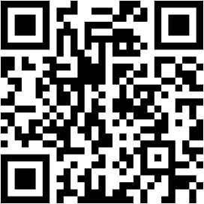
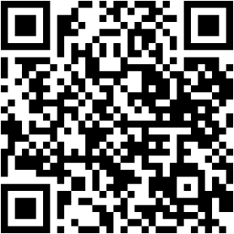
How To Start a Test Session Resources
Video
Quick Reference Guide
Starting, Monitoring, and Stopping a Test Session Video (11:31)
How to Start a Test Session Quick Reference Guide (PDF)
Notes:
In your resource guide are links to both a video and a quick reference guide that will repeat the steps we are covering here.
The QR codes are also on the slide.
In addition, there are specific instruction per grade level and grade spans for administering the ELPAC on the Administer a Test Session web page.
Let’s walk through it.
Resource Guide:
https://www.caaspp-elpac.org/resources/administration/administer-a-test-session

Slide 80
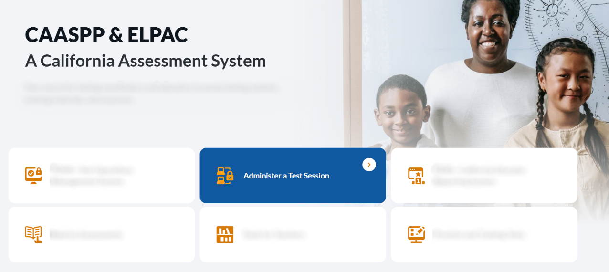
Access the Administer a Test Session Tile on the CAASPP & ELPAC Website
Notes:
The first step is to navigate to the CAASPP & ELPAC Website.
On the homepage you will select the Administer a Test Session tile.

Slide 81

Read the How to Start a Test Session Say Statements Verbatim
Notes:
Read the first part of the How to Administer an ELPAC Test Session Documents.
It is important to note, however, that the kindergarten through grade two writing instructions are only found in the secure DFA found in TOMS or the draft DFA in Moodle.
Remember to read it verbatim.
I want to pause and note here that we will be mentioning the DFA throughout this section.
You will read parts of the script at certain points during logon.
The point is to have all TEs across the state say the same thing in the same way.
The DFA is a helpful tool for you during testing.

Slide 82
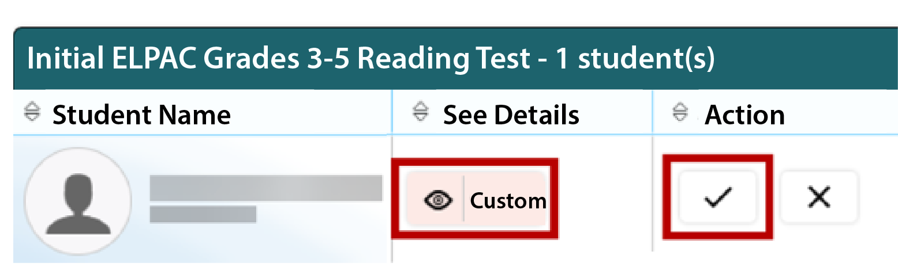
Check Accessibility Resources for Students
Notes:
It is extremely important to check the accessibility resource settings for students prior to approval to verify that the student is assigned the appropriate supports.
This is an example of one student’s information for Initial ELPAC Grades Three through Five Reading, where Student Name, See Details, and Action are column names.
Select the See Details eye icon to view the student’s settings for the current test.
For example, if the student had been assigned the designated support to turn off any universal tool(s), the test examiner can toggle the individual universal tools on and off.
“Custom” in the See Details column indicates the student has been assigned test settings.
Approve students to test by selecting the Approve check mark icon in the Actions column for individual students or the Approve All Students button for each group of tests.
It is important that test examiners get an up-to-date test settings report for their students from site coordinators to verify test settings displayed in the TE Interface.
If you know a student’s test settings are incorrect, deny the student by selecting Deny “X” icon.
[Insert local process to correct the test settings in TOMS and test the student on another day.]

Slide 83

Security Incidents and Cheating
Notes:
Remember, the assessments within ELPAC are secure.
Earlier we covered your role in terms of maintaining test security.
In this section we will talk about test security incidents and cheating.
Before we get started, please note that some incidents may require that an Appeal be submitted to request a grace period extension for an assessment. And, for the Initial ELPAC only, incidents may require an Appeal for a reset, restore, reopen, or rescore.
There are also some incidents that do not require an appeal at all to it’s important to understand the reason for submitting an Appeal.
Refer to the Security Incidents and Appeals Procedure Guide for more guidance when submitting STAIRS cases.
Resource guide:
https://ca-toms-help.ets.org/stairs/overview/

Slide 84

How to Handle Cheating
Notes:
Let’s discuss how to handle cheating.
In the case of a student cheating, the TE must stop the cheating and notify the site ELPAC coordinator.
If the situation involves a breach of test content to social media contact your LEA ELPAC coordinator or site ELPAC coordinator immediately, they will then submit a STAIRS case using the STAIRS/‌Appeals process.

Slide 85
Types of Security Incident: Breach
Breach
These have external implications.
A breach incident must be reported to your site or LEA coordinator immediately.
Notes:
But what about other types of security issues?
Well, there are three levels:
Breach
Irregularity
Impropriety
Breaches may include such situations as exposure of secure materials or an ongoing security or system risk.
These have external implications.
Examples of a breach are test items shared in social media or use of AI or chatbots or a TE modifying student answers.
A breach incident must be reported to your site or LEA coordinator immediately.
Our LEA coordinator is [insert name]
They will then report this to the testing contractor.

Slide 86
Types of Security Incident: Irregularity
Breach
Irregularity
These have external implications.
A breach incident must be reported to your site or LEA coordinator immediately.
These can be contained at the local level.
Take corrective action and notify the site coordinator.
Notes:
An irregularity is an unusual circumstance that impacts an individual or group of students who are testing and may potentially affect student performance on the test or impact test security or test validity.
These circumstances can be contained at the local level.
Examples of irregularities are student(s) who were assigned an incorrect designated support or accommodation, or student(s) who cheated.
For these types, local TEs or staff (that’s you) take corrective action and notify the site coordinator.
The site coordinator will submit a STAIRS case.

Slide 87
Types of Security Incident: Impropriety
Breach
Irregularity
Impropriety
These have external implications.
A breach incident must be reported to your site or LEA coordinator immediately.
These can be contained at the local level.
Take corrective action and notify the site coordinator.
These have a low impact and low risk.
Take corrective action and notify the site coordinator.
Notes:
An impropriety is an unusual circumstance that has a low impact on the individual or group of students who are testing and has a low risk of potentially affecting student performance on the test or of impacting test security or test validity.
Examples of improprieties during a test session are student(s) making distracting gestures or sounds [such as talking] or a disruption such as a fire drill or internet outage.
For these, local TEs or staff take corrective action and notify the site coordinator.

Slide 88
STAIRS: Security Test and Incident Reporting System
Insert information here about your local process.
Notes:
[Talk about your local STAIRS process.]

Slide 89

Activity: Show What You Know
Notes:
That was another big chunk of information, so we want to give you some processing time.
Let's do a quick check for understanding and show what you know! Respond by showing your answer by holding up the number of fingers for the answer or by writing the number for the answer on a card.
Notes for Facilitators:
You will say the statement on the slide.
Ask attendees to mark their answer either on scratch paper or electronically in the resource guide in the activities section.
Reteach as needed based on attendee responses.

Slide 90
Show What You Know #1
Question: Which ELPAC test materials are not secure?
  PFA
  DFAs
  Student's Logon Tickets
  Scratch Paper
Notes:
Question: Which ELPAC test materials are not secure?
PFA
DFA
Student's Logon Tickets
Scratch Paper
The correct response is 1, the PFA is not a secure document and does not need to be securely destroyed.

Slide 91
Show What You Know #2
Question: If a test item is shared on social media, what type of security incident is it?
  Irregularity
  Impropriety
  Breach
Notes:
Here's another opportunity to show what you know.
Again, show the answer by holding up your fingers or a card with the number for your answer.
Question: If a test item is shared on social media, what type of security incident is it?
An irregularity
An impropriety
A breach
The correct answer is 3. This example reflects a breach of test security.
A breach incident must be reported to the LEA coordinator immediately.
They will then report this to ETS.

Slide 92
Show What You Know #3
Question: A pause of 20 minutes means the student cannot return to previously answered segments, or questions, even if they are marked for review.
  True
  False
Notes:
Here's another opportunity to show what you know.
Again, show the answer by holding up your fingers or a card with the number for your answer.
Question: A pause of 20 minutes means the student cannot return to previously answered segments, or questions, even if they are marked for review.
True
False
The correct answer is 1, True!
A pause of 20 minutes means the student cannot return to previously answered segments, or questions, even if they are marked for review.

Slide 93

Preparing Students
Notes:
Let's talk about some ways to help prepare our students for testing.
Facilitator note: This section is optional and may be done as a separate training.

Slide 94


Practice is Important
Gain familiarity
Become comfortable
Use embedded tools
Resources for student practice
Notes:
Practice is an important piece in preparing students and staff for testing.
By utilizing available resources, students and staff gain familiarity with the testing platform, become more comfortable with different item types, and understand how to navigate within the system.
It is good to build familiarity with the testing system prior to summative testing.
Students with designated supports and accommodations can test their utility and learn how to use those embedded tools to ensure fair and valid testing. And practice gives all students the opportunity to become familiar with universal tools.
Practice will reduce the number of system usage errors and security and administration incidents, reduce apprehension of the process, reduce test anxiety in students, and provide for a smoother summative testing experience.
There are resources for student practice that are available to students, teachers, parents, and administrators, so anyone can practice, not just students!

Slide 95

Practice
Tests
Notes:
We are going to start with Practice Tests as resources for student practice.

Slide 96

Practice Test Goal
Format and structure
Experience ELPAC
Scoring guides
Accommodations
Notes:
The goal of the practice tests is to expose students, parents, teachers, and test administrators or examiners to the tests so they may become familiar with the format and structure of a summative assessment.
Practice tests provide students with the opportunity to experience ELPAC at each grade level or grade span tested.
Scoring guides are available for the practice tests, but the tests themselves are not automatically scored, regardless of how they are administered.
The practice and training tests contain embedded universal tools, designated supports, and accommodations that are part of the online test administration system, in order to provide students with a grade-level, subject specific experience of their use.
Also please keep in mind, students can log on using their SSID or as a guest to access the practice and training test.

Slide 97

Taking a Practice Test
Students can take a practice or training test at school, or at home in an unmonitored environment.
Notes:
Students can take a practice or training test at school, or at home in an unmonitored environment.
Or the teacher may launch a test session and have students access the test through the secure browser.
By practicing the "log on" and "approval" processes, both the teacher and students gain experience together with the testing platform.
It is best to have the students practice using the secure browser that they will be using during the summative testing.
For the Alternate ELPAC, ELPAC Speaking domain, and ELPAC Grades K, 1 and 2 (except Writing domain in 2) administration is one-on-one using the directions for administration, which we call DFAs.
Again, the practice tests are not scored automatically, but hand scoring is an option, with scoring guides, answer keys, and rubrics available to provide details on test items, student response types, correct responses, and alignment with state standards, making them valuable resources for teachers.

Slide 98
Practice Test Availability
Summative ELPAC
Summative Alternate ELPAC
Smarter Balanced for ELA and Mathematics
California Alternate Assessments (CAAs) for ELA and Mathematics
California Science Test (CAST)
CAA for Science
California Spanish Assessment
Notes:
Practice Tests are available for the following assessments:
Summative ELPAC, where there is one per domain for the same grade levels and grade spans as the Summative ELPAC
Summative Alternate ELPAC
Smarter Balanced Summative Assessments for ELA and mathematics
The California Science Test, or CAST
California Alternate Assessments, or CAAs, for ELA, mathematics, and science
And the California Spanish Assessment, or CSA

Slide 99
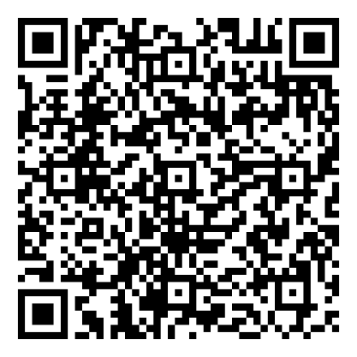
Do Your Best on the Test Video Playlist
Do Your Best On The Test YouTube Video Playlist
Notes:
The Do Your Best on the Test video showcase invites kindergarten through grade twelve students, individually or in teams, to share how they prepare to do their best on statewide assessments and why testing is important. Participants may be selected to have their video featured on the CAASPP & ELPAC YouTube channel and in social media posts. They may also have portions of their video incorporated into promotional materials shown to students throughout California to inspire other students to do their best on the tests.
A special shout out to Ingenium Charter School for showing us how their students do their best on the test! Let's view 2024–25 video submissions. (Play link)
This year so far, we have received many engaging, fun, and creative submissions from students across the state, highlighting topics such as:
Why statewide testing is important
How statewide testing supports college and career readiness
Ways statewide testing improves teaching and learning
How students prepare for statewide testing, such as tips to feel their best
Impact of reclassification (ELPAC only)
Video Series Playlist: https://www.youtube.com/watch?v=-FwzhHqo1jU&list=PLFEmF7tMjzzjCsojNX9hhX2zxWF40hplE}

Slide 100

Interim Assessments
Notes:
Students can also prepare to test with Interim Assessments.

Slide 101

Interim Assessments Reminders
California Education Code
Security Requirement
Notes:
Before we dive in, we want to mention a few things about interim assessments.
California Education Code Section 60642.7 (b) prohibits the use of interim assessments for any high stakes purposes such as course placement, identification as gifted or talented, or reclassification of English learners.
Another important note is that the interim assessments are available only for public school educators (and their students) in California and are not for public use, display or distribution. All test materials—such as test questions, scoring guides, answers keys, scratch paper and student logon tickets—must be kept secure. They may not be used outside of the classroom or posted into third party platforms such as Google Classroom or Canvas.
They may only be used within the systems provided by the California Department of Education.
And the Interim Assessments require a Test Operations Management System, or TOMS, logon to access.

Slide 102

Interim Assessment Purposes
Inform and support teaching and learning
Evaluate student knowledge and skills
For and of learning
Offer accessibility resources
Notes:
Let's focus on the purposes of interim assessments.
Interim assessments are free resources which can inform and support teaching and learning in multiple ways.
Their intended purpose is to evaluate student knowledge and skills during the year.
Interim assessments can be used flexibly as both assessments for learning and of learning.
This means that interim assessments can be administered in a standardized manner, as a formal individual assessment, or in a non-standardized manner, which we will discuss more on the next slide.
The interim assessments provide the full range of CAASPP and ELPAC accessibility resources, allowing students to demonstrate their knowledge and abilities using the same tools they regularly use during classroom instruction and summative assessments.
As you review this lesson, think about your own classroom, school, or district and where the interims might fit. Also, consider how you could utilize interim assessments to inform and develop your own classroom assessments.

Slide 103

Administration Options
Any grade level
Standardized way
Nonstandardized way
Flexibility
California Department of Education (CDE) systems
Notes:
The interim assessments may be administered at any grade level to any student.
The interims assessments may be administered in a standardized way, which is administering the interim assessments in the same way the Summative is administered, or the Interims may be administered in a nonstandardized way, meaning:
Students might work on test items with other students, such as in pairs or small groups.
The teacher might even lead a whole class lesson while displaying an interim test item like a stand-alone question, a short response question, or a performance task.
This provides educators with the flexibility to use the interim assessments as best suits their instructional needs.
Interim assessment results in the California Educator Reporting System, or CERS, provide item-level information to support teaching and learning.
Also note that interim assessments are secure, so they may not be posted into third-party platforms.
They may only be used within the systems provided by the California Department of Education, or CDE.
And interims are student and teacher facing only.
For students attending school remotely, the interims are available for remote administration, with or without the use of the secure browser.

Slide 104
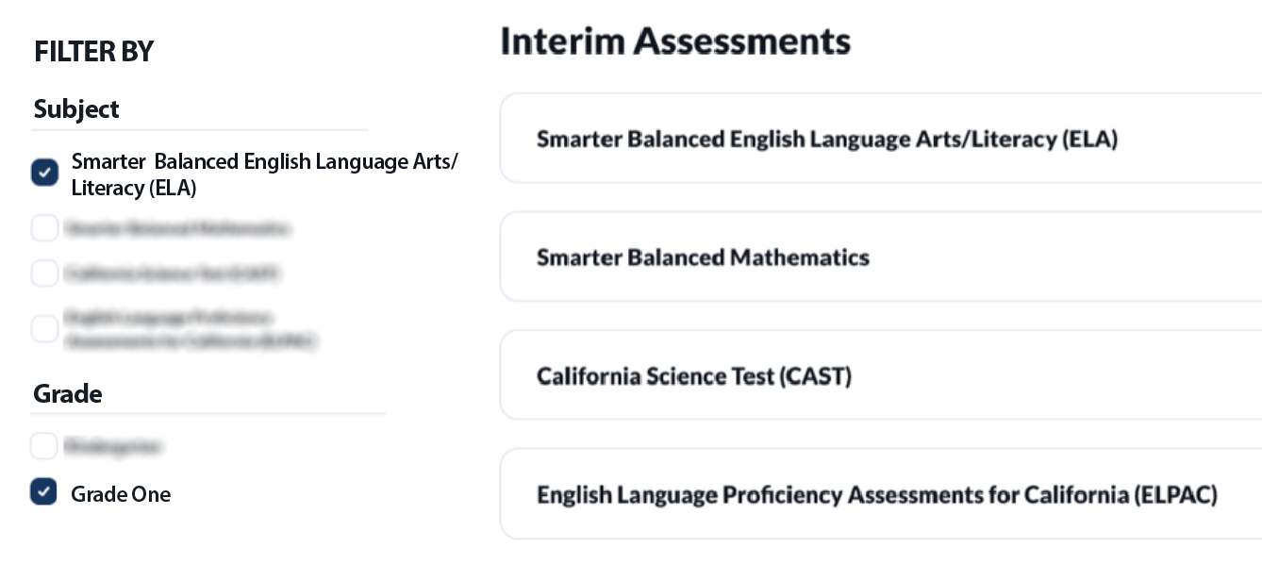
Interim Assessment Lookup Tool
Notes:
Interim assessments are available all year long, however, the new interim assessments for the school year usually rollover in late summer.
There is a web page that lists all the interim assessments that are available, The Interim Assessment Lookup Tool, so we don’t have to list them all here.
The links for the IA Lookup Tool web page is in the resource guide.
We also want to note that all interim assessments are administered on the computer but are not computer-adaptive.
They include a fixed set of items, and every student gets the same items.
There is one exception to the computer-based setup, which we will mention on the ELPAC slide.
And lastly, some interim assessments contain items that require hand scoring.
The new web page will list how many hand scoring items are required for each interim assessment.
This information is important to know because when an assessment has a hand-scored item, the item will need to be scored locally and submitted before the assessment results will display in CERS.

Slide 105

ELPAC Interim Assessments
Available for all domains and grade spans
Fixed-form, computer-based tests
Administered both
one-on-one and in groups
56 ELPAC Interim Assessments available
Notes:
The ELPAC has an interim assessment for each domain and for all grade levels and grade spans as the Summative ELPAC.
The ELPAC Interim Assessments are fixed-form, computer-based tests.
ELPAC Interim Assessments may be administered in both one-on-one and group settings.
There are 56 ELPAC Interim Assessments available for use. The ELPAC Interim Assessment items are from the same item bank as the Summative ELPAC. Each ELPAC Interim Assessment contains 4–12 items depending on the domain.
Resources:
ELPAC Training Tests, Practice Tests, and Interim Assessments At-a-Glance
ELPAC Interim Assessments Fact Sheet

Slide 106

Smarter Balanced
Interim Assessments
Interim Comprehensive Assessments (ICAs)
Interim
Assessment
Blocks (IABs)
Focused
Interim Assessment Blocks (FIABs)
Notes:
Since there is not time to list all the interim assessments, let’s dig into how they are organized.
For Smarter Balanced for ELA and math they are organized by the content they assess.
The Interim Comprehensive Assessments (ICAs) test the same content and report scores on the same scale as the summative assessments.
With the Smarter Balanced adjusted form assessments, the ICAs will actually take longer than the summative to administer as they align more with the full-form summative assessment blueprint.
They can be administered up to three times a year.
Each ICA includes one or more items that require hand scoring.
Interim Assessment Blocks (IABs) focus on smaller sets of related concepts and provide more detailed information for instructional purposes.
They generally have from 6 to 18 items and can be administered within one class period.
They could be administered an unlimited number of times, but it is important to note that there is currently only one form for each IAB so students would experience the same items if the assessment is given more than one time.
Focused IABs (FIABs) assess even smaller “chunks” of content (generally one to three assessment targets).
They generally have 10-15 items focused on very specific concepts.

Slide 107




CAST Interim Assessments
Elementary School
Middle
School
High
School
Grade three
Earth and Space
Earth and Space
Grade four
Life
Life
Grade five
Physical
Physical
Notes:
CAST Interim Assessments are organized in two ways.
In elementary school, they are organized by grade level performance expectations, so the CAST Interim Assessments for grades three, four, and five assess all three science domains (Earth and Space Sciences, Life Sciences, and Physical Sciences)
In middle school and in high school, the CAST Interim Assessments are organized by science domains, so there are three middle school and three high school CAST Interim Assessments, and they each assess one science domain.
Each interim will include one performance task with a constructed response that will require hand scoring.

Slide 108

Interim Assessment Results in CERS
Item viewer
Item information
Key/Distractor Analysis
Rubric and exemplar
Student responses to items
Links to instructional resources
Notes:
[Remove this slide if you do not roster students to teachers in CERS.]
For all interim assessments, we get the following data in CERS, or the California Educator Reporting System:
The grade level assessed
Average Score for the group
Number of students in the results
Student score distribution by level
Individual student results
However, we also get additional information which is specific only to the interim assessments, such as:
Item viewer
Item information for example, standard, claim, and depth of knowledge
A Key/Distractor Analysis, which shows an answer key that displays the number or percent of students that have chosen each answer choice
Rubric and exemplar information
Student responses to items; and
Links to instructional resources for the smarter balanced IABs and focused IABs

Slide 109
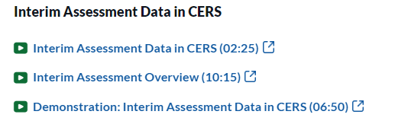
CERS Microlearning Videos
All training videos can be found on the
CAASPP & ELPAC Upcoming and On-Demand Trainings web page.
Notes:
[Remove this slide if you do not roster students to teachers in CERS.]
Lastly, we want to call out the that training on how to access this data in CERS was recorded as a series of microlearning videos, so you can watch the whole thing OR access just the parts you want.
These videos include Interim Assessment Data in CERS, an Interim Assessment Overview, and a Demonstration of Interim Assessment Data in CERS.
These can be found on the Upcoming and On Demand Trainings page of the CAASPP & ELPAC Website.

Slide 110

Thank you for attending!
Notes:
Thank you for attending this training!

